Slide 1
Angular

Slide 2
Why scripting languages.
There are many advantages of using a scripting language. First, they are open source. Therefore, anyone around the world can use it and contribute to it.
Second, if you are a beginner, they are a great way to start with programming languages, as they are quite easy to learn and code.
As we know that most scripting languages use an interpreter, and unlike compilers, no executable file is stored, and hence, they require less memory.
They are portable, i.e., can run on different operating systems.
Scripts are also used as a prototype before building an actual program.

Slide 3
What is a framework.
Software frameworks make life easier for developers by allowing them to take control of the entire software development process, or most of it, from a single platform.
Advantages of Framwork
Assists in establishing better programming practices and fitting use of design patterns
Code is more secure
Duplicate and redundant code can be avoided
Helps consistent developing code with fewer bugs
Makes it easier to work on sophisticated technologies
One could create their software framework or contribute to open-source frameworks. Hence, there is a continuous improvement in the functionality
Several code segments and functionalities are pre-built and pre-tested. This makes applications more reliable
Testing and debugging the code is a lot easier and can be done even by developers who do not own the code
The time required to develop an application is reduced significantly

Slide 4
What is MEAN Stack
The MEAN stack is JavaScript-based framework for developing web applications. MEAN is named after MongoDB, Express, Angular, and Node, the four key technologies that make up the layers of the stack.
MongoDB - document database
Express(.js) - Node.js web framework
Angular(.js) - a client-side JavaScript framework
Node(.js) - the premier JavaScript web server
There are variations to the MEAN stack such as MERN (replacing Angular.js with React.js) and MEVN (using Vue.js). The MEAN stack is one of the most popular technology concepts for building web applications.

Slide 5
What is Full sack
Full stack development: It refers to the development of both front end(client side) and back end(server side) portions of web application.
Full stack web Developers: Full stack web developers have the ability to design complete web application and websites. They work on the frontend, backend, database and debugging of web application or websites.

Slide 6
What is Angular
Angular is a development platform, built on TypeScript. As a platform, Angular includes:
A component-based framework for building scalable web applications
A collection of well-integrated libraries that cover a wide variety of features, including routing, forms management, client-server communication, and more
A suite of developer tools to help you develop, build, test, and update your code

Slide 7
Why Angular
One of the biggest advantage of Angular is that it is supported by Google.
Supports typescript : Angular applications are built using TypeScript language, a superscript for JavaScript, which ensures higher security as it supports types (primitives, interfaces, etc.). It helps catch and eliminate errors early when writing the code or performing maintenance tasks.
Uses HTML for UI : Angular uses HTML to define the UI of the application.
Angular can be easily tested.
It has MVC pattern.

Slide 8
Why Angular
Good Reusability
Simplified Unit-Testing
Improved Readability
Ease of Maintenance

Slide 9
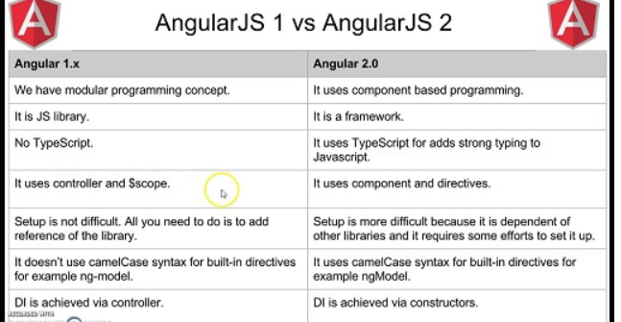
Difference between Angular 1 and Angular 2

Slide 10
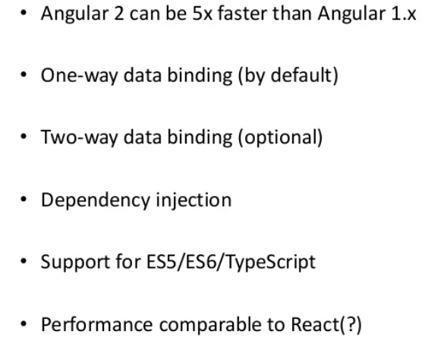
Features of Angular 2

Slide 11
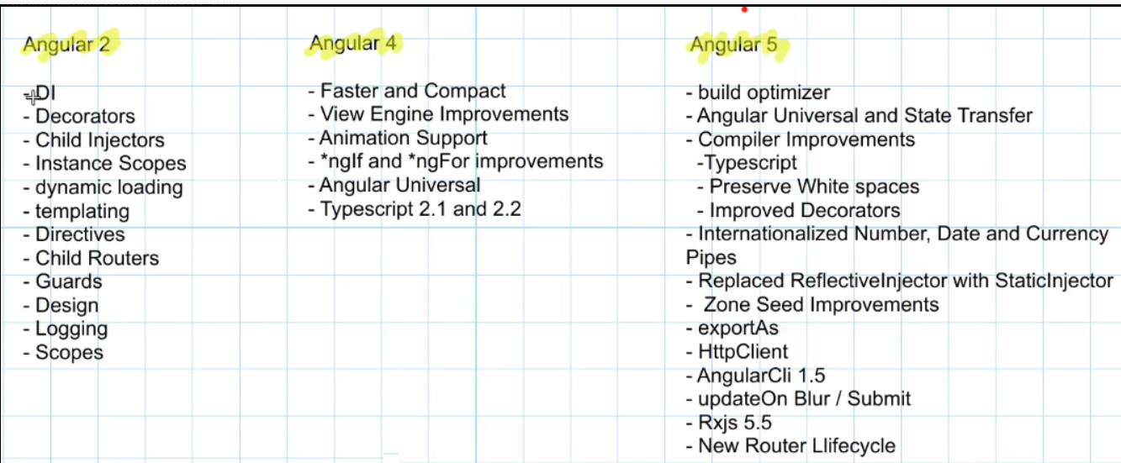
Features of Angular 2, 4, 5

Slide 12
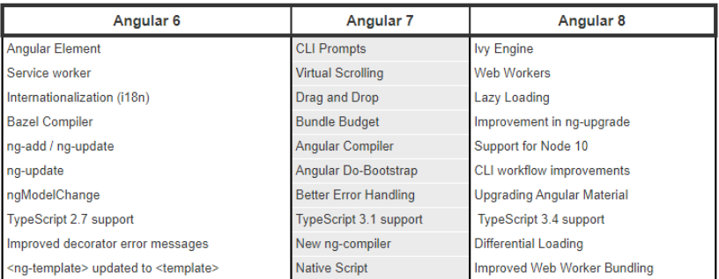
Features of Angular 6,7,8

Slide 13
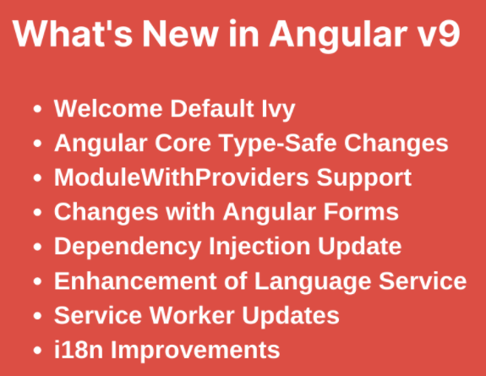
Features of Angular 9

Slide 14
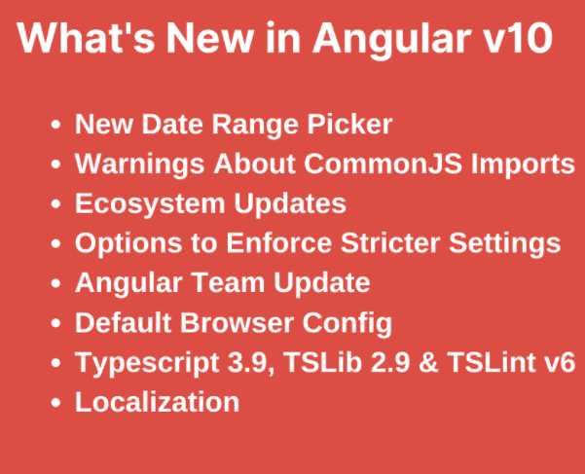
Features of Angular 10

Slide 15
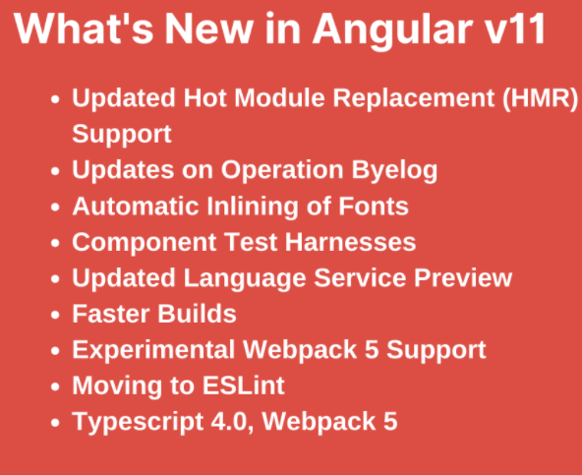
Features of Angular 11

Slide 16
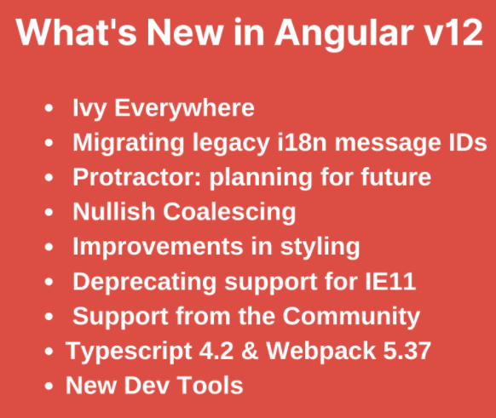
Features of Angular 12

Slide 17
Features of Angular 13
It is 100% IVY.
Has a simplified API.
Improvements in Angular CLI.
Angular Package Format (APF) changes.
IE11 support is removed.
Testbed updates.
Typescript 4.4 support
Improved error messaging
Default RxJS 7.4 for apps created with ngnew
Dynamic enabling and disabling of built-in validator
The introduction of FormControlStatus for forms
New type support for language service.

Slide 18
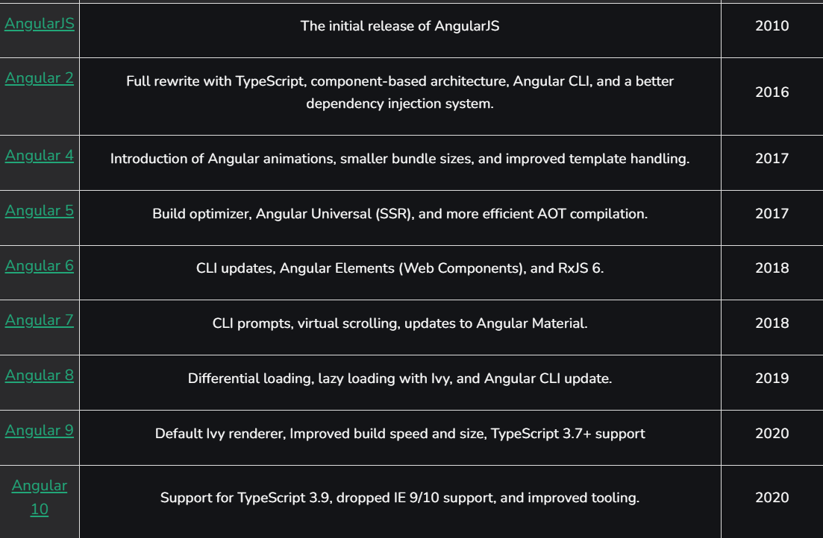
Angular Versions.

Slide 19
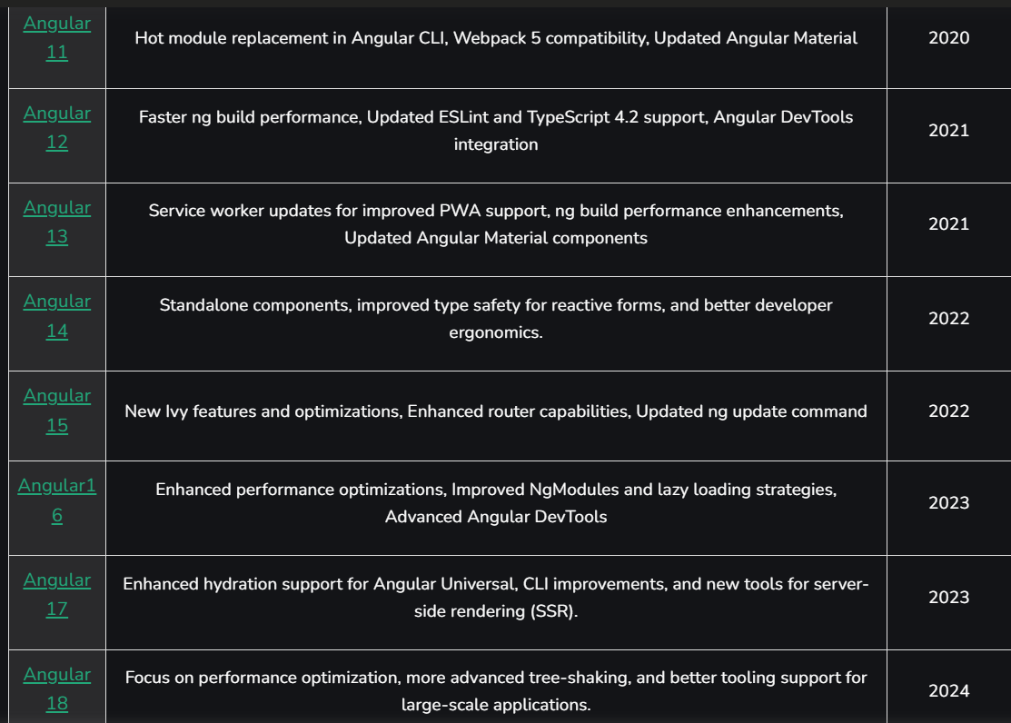

Slide 20
Angular CLI.
Angular CLI is used to create projects, generate application and library code, and perform a variety of ongoing development tasks such as testing, bundling, and deployment.

Slide 21
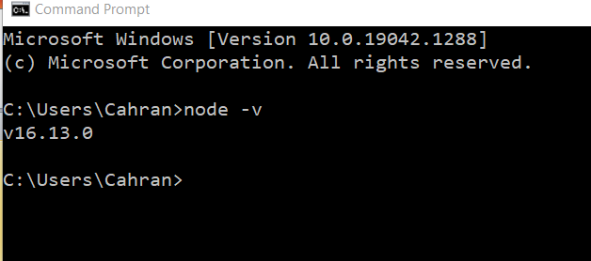
Install node.
Follow these steps for installation
1. Install node from this site https://nodejs.org/en/download/prebuilt-installer
after the installation check the version of node and npm as
node -v and npm -v
2.Install the typescript with npm install -g typescript.
3. Check typescript version as tsc -v
4. npm install -g @angular/cli
5. ng new MyProject1 --no-standalone

Slide 22
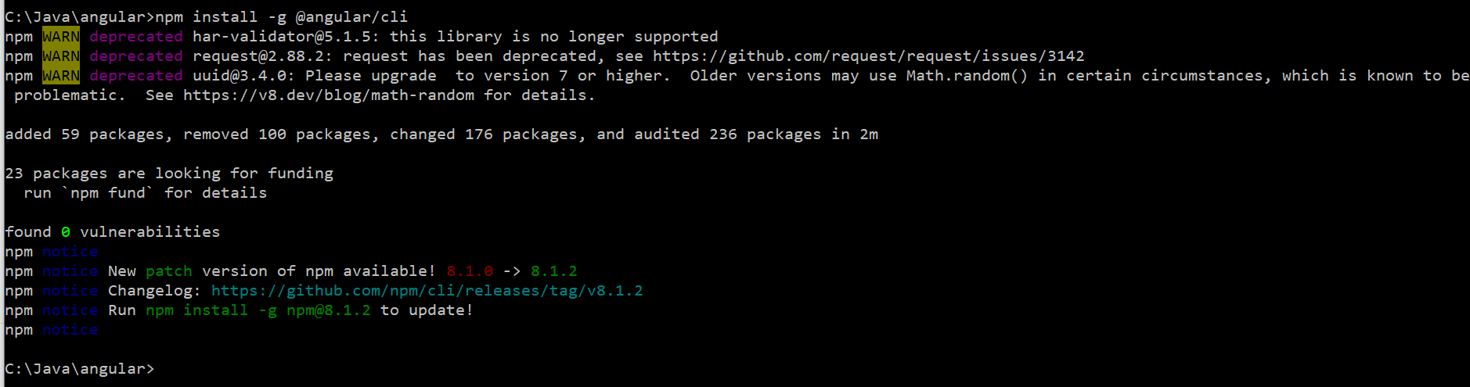
Installing angular
From the command prompt, give the command
npm install –g @angular/cli

Slide 23
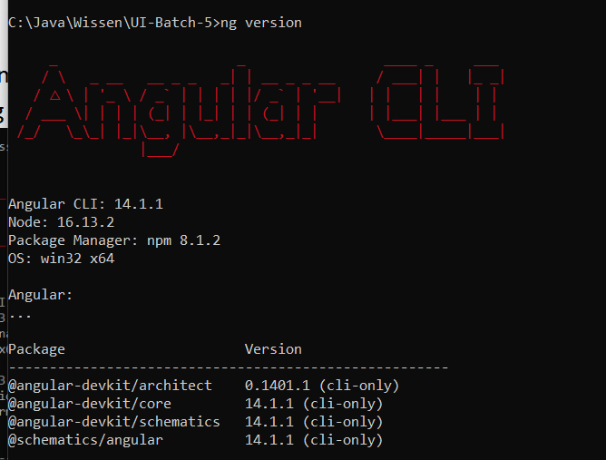
Check angular version.
From the command prompt, give the command
Ng version

Slide 24
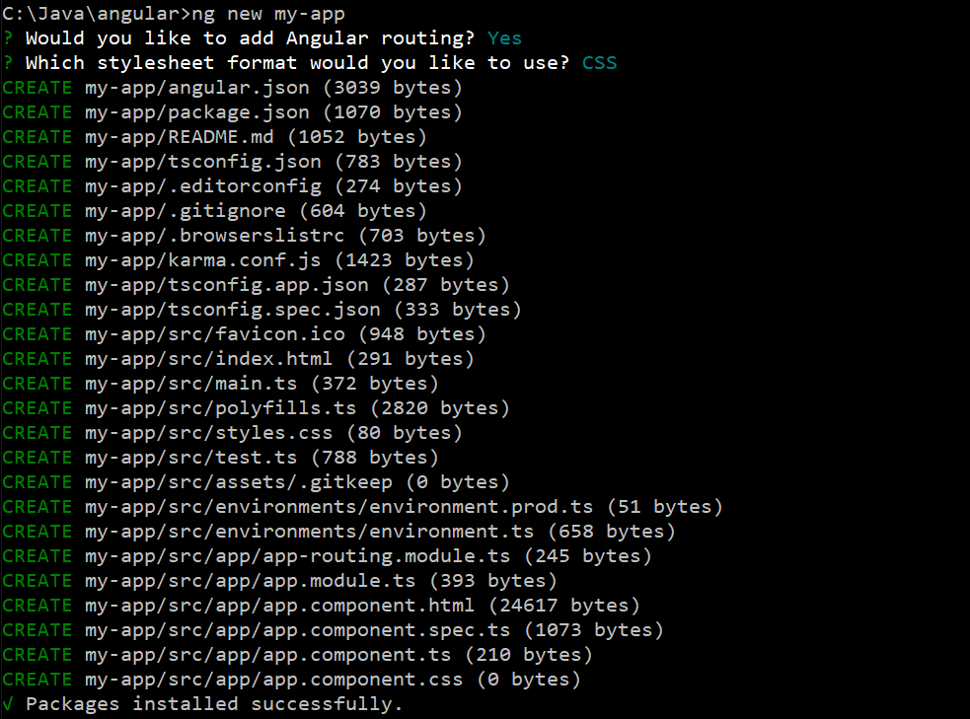
Create a new project in Angular
From the command line, give the command
ng new <project name>

Slide 25
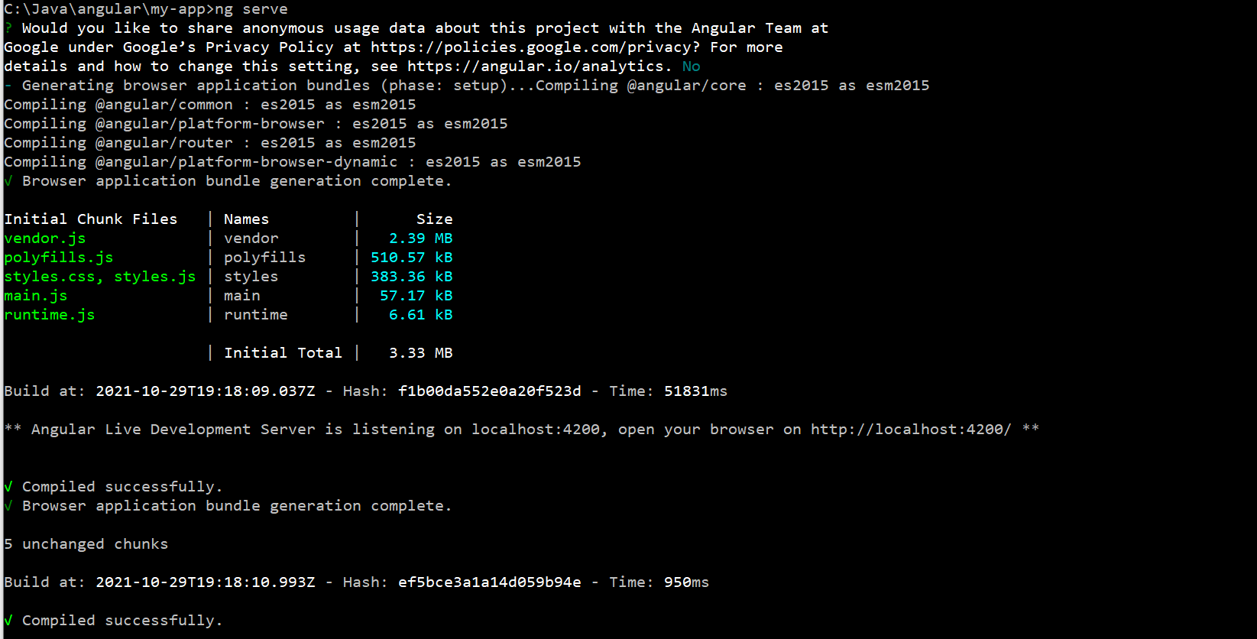
Start angular server
ng serve → At the command line will start the angular server at port 4200.

Slide 26
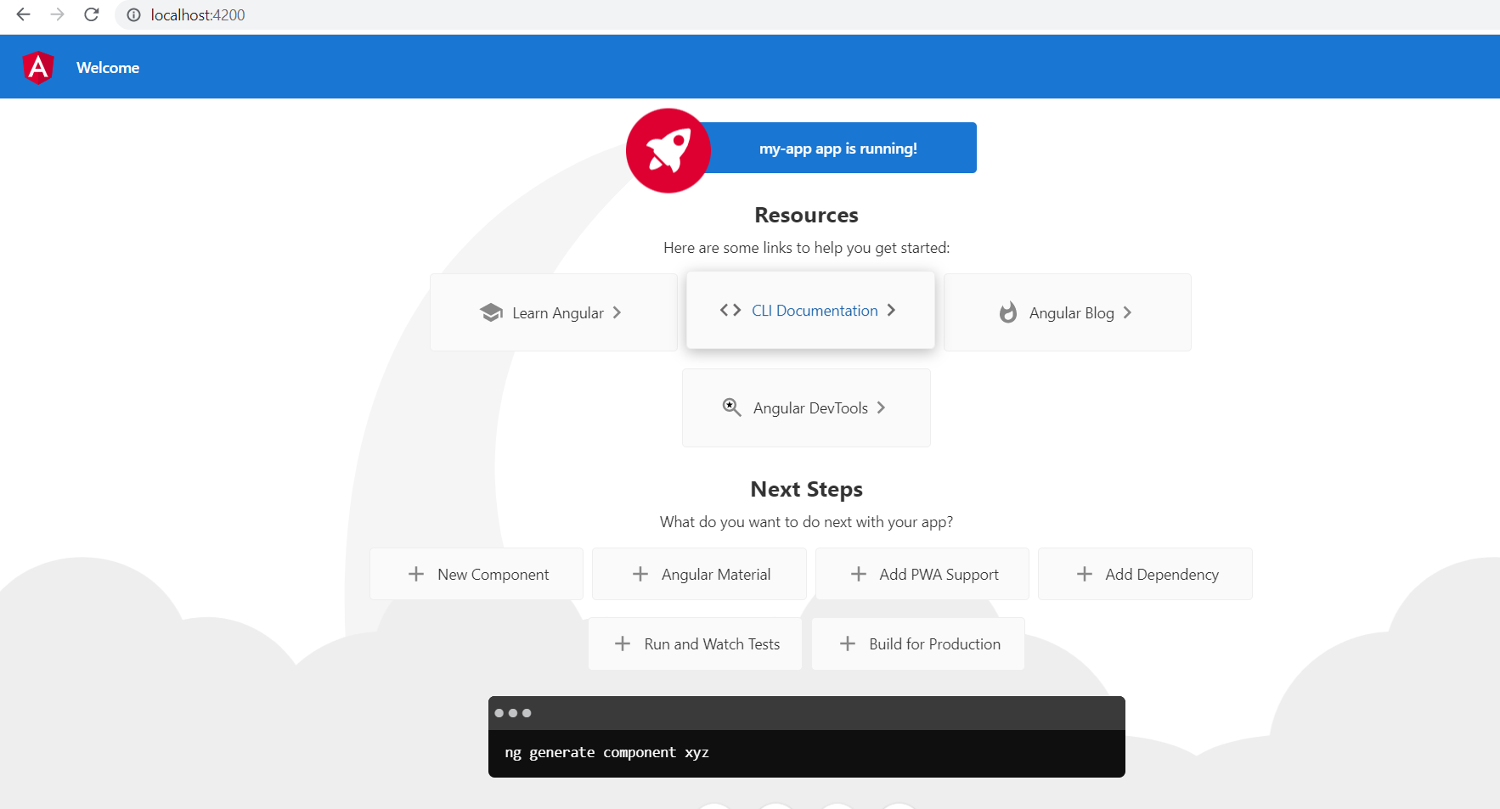
Angular installation check
Run http://localhost:4200 in the browser. It generates the following output.

Slide 27
ECMA script.
ECMA Script : The full form of ECMA is European Computer Manufacturer's Association. ECMAScript is a Standard for scripting languages such as JavaScript, JScript, etc. It is a trademark scripting language specification. JavaScript is a language based on ECMAScript. A standard for scripting languages like JavaScript, JScript is ECMAScript. JavaScript is considered as one of the most popular implementations of ECMAScript.

Slide 28
History of ECMA Script.
JavaScript was originally named Mocha and changed to Livescript but ultimately became JavaScript.
It's important to note that JavaScript came before ECMAscript and the history will tell you why.
To start from the beginning, JavaScript derived its name from Java and initially Brendan Eich (the creator of JS) was asked to develop a language that resembled Java for the web for Netscape.
Eich, however decided that Java was too complicated with all its rules and so set out to create a simpler language that even a beginner could code in. This is evident in such things like the relaxing of the need to have a semicolon.
After the language was complete, the marketing team of Netscape requested Sun to allow them to name it JavaScript as a marketing stunt and hence why most people who have never used JavaScript think it's related to Java.
About a year or two after JavaScript's release in the browser, Microsoft's IE took the language and started making its own implementations such as JScript. At the same time, IE was dominating the market and not long after Netscape had to shut its project.
Before Netscape went down, they decided to start a standard that would guide the path of JavaScript, named ECMAScript. The full form of ECMA is European Computer Manufacturer's Association

Slide 29
ES5 features
USE Strict is introduced. With this variables cant be used without declaring them.
New methods for array are introduced.
JSON support.
New Methods in date are added.

Slide 30
Features of ES6
Let and Const are introduced.
For..of
Default parameters of the functions.
Rest operator → Any number of parameters can be passed to a function with …<variable name> as the function parameter.
Spread Operator.
Destructuring.
Template literals.
Arrow functions.
Promises.
Classes.

Slide 31
Features of ES7.
Exponent Operator using ** and couple of functions added.

Slide 32
Transpiler & ts-node.
Transpilers, or source-to-source compilers, are tools that read the sourcecode written in one programming language and produce the equivalent code in another programming language
Typescript Transpiler will convert from .ts file to its corresponding .js file.. Converts from Typescript to JavaScript.
ts-node is a TypeScript execution engine and REPL for Node.js.

Slide 33
Typescript.
TypeScript is an open-source object-oriented programming language. It was launched and introduced on October 1st, 2012. TypeScript follows JavaScript syntactically but adds more features to it. It is a superset of JavaScript. It is developed and maintained by Microsoft under the license of Apache 2. It does not directly run on the browser and requires a compiler to compile and generate a TypeScript file.

Slide 34
Features of Typescript.
Object-Oriented language: TypeScript provides a complete feature of an object-oriented programming language such as classes, interfaces, inheritance, modules, etc. In TypeScript, we can write code for both client-side as well as server-side development.
TypeScript is portable: TypeScript is portable because it can be executed on any browsers, devices, or any operating systems. It can be run in any environment where JavaScript runs on. It is not specific to any virtual-machine for execution.
TypeScript is just a JS: TypeScript code is not executed on any browsers directly. The program written in TypeScript always starts with JavaScript and ends with JavaScript. Hence, we only need to know JavaScript to use it in TypeScript. The code written in TypeScript is compiled and converted into its JavaScript equivalent for the execution. This process is known as Trans-piled. With the help of JavaScript code, browsers can read the TypeScript code and display the output.

Slide 35
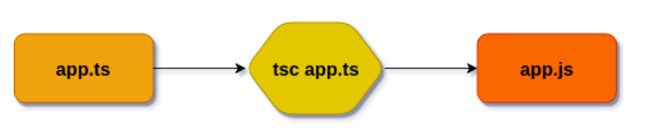
Typescript compilation procedure

Slide 36
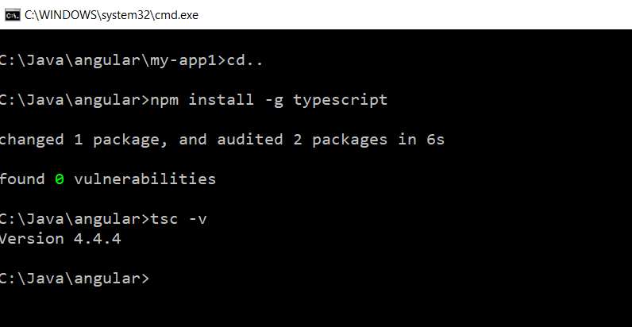
Install typescript.
Npm install –g typescript → this will install the typescript.
Tsc –v → Will give the typescript version.

Slide 37
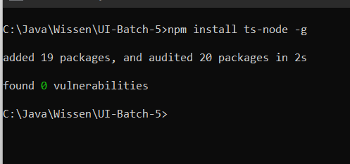
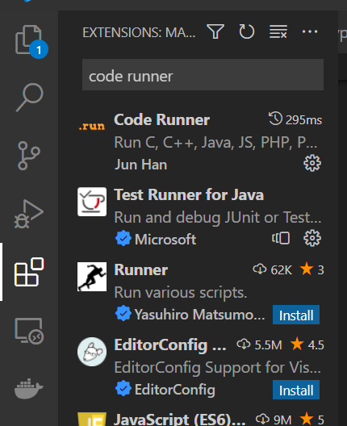
Install ts-node.
Npm install –g ts-node
Install code runner in Visual Studio

Slide 38
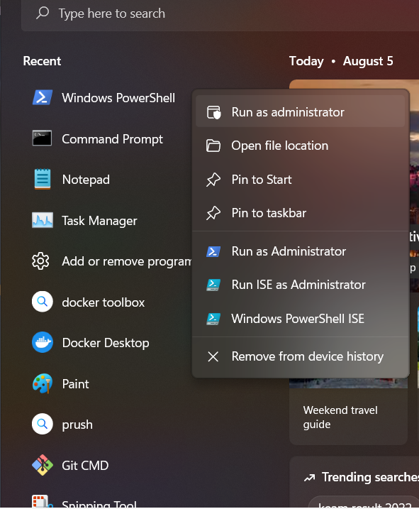
Open windows powershell
Open Windows powershell in Adminstrator Mode.

Slide 39
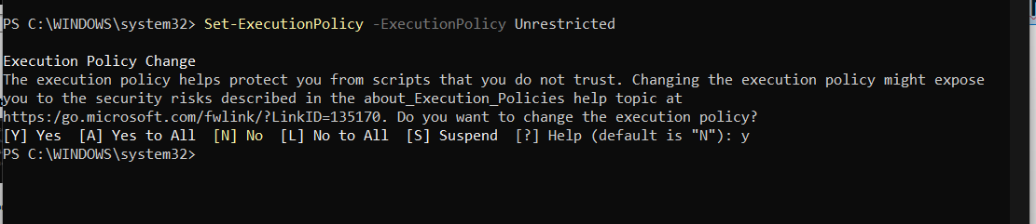
Install ts-node.
Run the following command
Set-ExecutionPolicy -ExecutionPolicy Unrestricted
After typing the typscript, run the code from editor itself.

Slide 40
Enable decorators
To enable decorators, give the following command in the command line
Tsc –target ES5 --experimentalDecorators

Slide 41
Basic building blocks of Angular
Modules --
Components
Templates → A template is a form of HTML that tells Angular how to render the component.
Metadata
Data binding
Directives
Services
Dependency injection

Slide 42
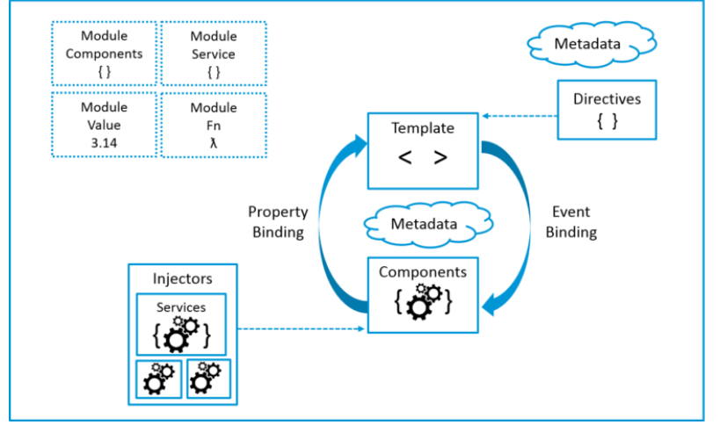
Building blocks of Angular.

Slide 43
Angular – Modules.
Angular apps are modular and to maintain modularity, we have Angular modules or you can say NgModules. Every Angular app contains at least one Angular module, i.e. the root module. Generally, it is named as AppModule. The root module can be the only module in a small application. While most of the apps have multiple modules. You can say, a module is a cohesive block of code with a related set of capabilities that have a specific application domain or a workflow. Any angular module is a class with @NgModule decorator.
Like JavaScript modules, NgModules can import functionality from other NgModules, and allow their own functionality to be exported and used by other NgModules. For example, to use the router service in your app, you import the Router NgModule.

Slide 44
App.module.ts
import { NgModule } from '@angular/core';
import { BrowserModule } from '@angular/platform-browser';
import { AppRoutingModule } from './app-routing.module';
import { AppComponent } from './app.component';
@NgModule({
declarations: [
AppComponent
],
imports: [
BrowserModule,
AppRoutingModule
],
providers: [],
bootstrap: [AppComponent]
})
export class AppModule { }

Slide 45
Angular Component.
A component controls one or more sections on the screen called a view. For example, if you are building a course list application, you can have components like App Component (the bootstrapped component), Course Component, Course Detail Component, etc.
Inside the component, you define a component’s application logic i.e. how does it support the view—inside a class. The class interacts with the view through an API of properties and methods.
Every app has a main component that is bootstrapped inside the main module, i.e AppComponent. The following code is in app.component.ts
import { Component } from '@angular/core';
@Component({
selector: 'app-root',
templateUrl: './app.component.html',
styleUrls: ['./app.component.css']
})
export class AppComponent {
title = 'my-app';
}

Slide 46
ngModule :
An NgModule is a class marked by the @NgModule decorator. @NgModule takes a metadata object that describes how to compile a component's template and how to create an injector at runtime. It identifies the module's own components, directives, and pipes, making some of them public, through the exports property, so that external components can use them.
BrowserModule:
BrowserModule provides services that are essential to launch and run a browser application.
AppRoutingModule : It is an NgModule where you can configure your routes.
import { AppComponent } from './app.component'; → Importing AppComponent class from app.component.ts file..
Declarations in @ngModule: The module's declarations array tells Angular which components belong to that module. As you create more components, add them to declarations.
Imports section : These modules are imported into the current module of ngModule.
Providers section : This section will list all the services of the project.
bootstrap: [AppComponent] means A bootstrapped component is an entry component that Angular loads into the DOM during the bootstrap process (application launch)

Slide 47
Purpose of Angular/Core
Defines the class infrastructure for components, view hierarchies, change detection, rendering, and event handling.
Defines the decorators that supply metadata and context for Angular constructs. - @Component is the decorator which is part of metadata.
Defines infrastructure for dependency injection (DI), internationalization (i18n), and various testing and debugging facilities.
What is a selector:
A selector is one of the properties of the object that we use along with the component configuration.
A selector is used to identify each component uniquely into the component tree,

Slide 48
What is metadata.
Metadata is the data about data or information about the class. Decorators are used to do this work.
The whole purpose of Angular decorators is to store metadata about a class, method, or property. When you configure a component, you are providing a metadata for that class that tells Angular that you have a component, and that component has a specific configuration. Each decorator has a base configuration with some default values. When the decorator is created using the relevant factory, the default configuration is passed.
There are four types of decorators in Angular:
Class Decorators - @ngModule decorator is used in app.module.ts to provide information about the class AppModule.
Property Decorators : @Input is used to communicate property data from parent to child component.
Method Decorators : @HostListener. This tells Angular that when an event on your host happens, you want the decorated method to be called with the event
Parameter Decorators : Parameter decorators are used to decorate parameters in your class constructors. For example- @Inject. It tells Angular that what you want that parameter to be initiated with. More about this can discussed during services in Angular.

Slide 49
Directives and Services.
Directives are classes that add additional behavior to elements in your Angular applications.
Attribute directives—directives that change the appearance or behavior of an element, component, or another directive. ngStyle, ngClass
Structural directives—directives that change the DOM layout by adding and removing DOM elements. ngIf, ngFor, ngSwitch etc.,
Services : Service is a broad category encompassing any value, function, or feature that an application needs. A service is typically a class with a narrow, well-defined purpose. It should do something specific and do it well.

Slide 50
Dependency Injecton.
Dependencies are services or objects that a class needs to perform its function. Dependency injection, or DI, is a design pattern in which a class requests dependencies from external sources rather than creating them.
Angular's DI framework provides dependencies to a class upon instantiation. Use Angular DI to increase flexibility and modularity in your applications.

Slide 51
Files/Directories in Angular Project.
Node_modules : This directory will show the modules installed by npm.
Src/app – Directory for writing the code for the application.
Under src/app
App.routing.module.ts → For routing purpose.
App.component.css → For css styling of app component.
App.component.html → HTML file for app component.
App.component.spec.ts → For unit testing of Angular.
App.component.ts → Typescript file for main angular component.
App.module.ts → It will define about the module.
Assets – Files placed under this directory, can be accessed through http client directly and with the browser also. Create a file test.json add some json into it and it can be accessed through browser using the URL
http://localhost:4200/assets/test.json
Environment – We can setup the environment for test, staging, production etc.,
Favicon.ico → For icon of the application.

Slide 52
Index.html -
Main.ts - Angular started with main.ts.
Then we bootstrap an angular application and we pass app.module.ts as an argument. In app.module.ts we tell angular: "There is the app component which you should know when you try to start yourself".
And angular now analyze this app component, reading the set up we pass there and there is SELECTOR app-root.
Now, angular is enable to handle app-root in the index.html and knows rules for the SELECTOR.
SELECTOR should insert the app components and have some HTML code - a template attached to him - html component.
This is how Angular application starts.
Polyfill.ts - Angular is built on the latest standards of the web platform. Targeting such a wide range of browsers is challenging because they do not support all features of modern browsers. You compensate by loading polyfill scripts ("polyfills") for the browsers that you must support. See instructions on how to include polyfills into your project below.
Styles.css
Test.ts – For testing purpose.
Browserslistrc – Lists the supported browsers. From the command prompt, give the command c:\>npx browserslist → This will give the supported browsers.
Editorconfig – Editor configuration information is provided in this file.
Gitignore → .gitignore is an plain text file that contains list of files/folders paths, that means, these files are not committed to repositories while committing a projects.

Slide 53
Angular.json → A file named angular.json at the root level of an Angular workspace provides workspace-wide and project-specific configuration defaults for build and development tools provided by the Angular CLI.
Karma.conf.js → For testing purpose.
Package-lock.json → package-lock. json is automatically generated for any operations where npm modifies either the node_modules tree, or package. json.
Package.json → Once you create new Angular application, you will see package.json file among the newly created files and folders. package.json file locates in project root and contains information about your web application. The main purpose of the file comes from its name package, so it'll contain the information about npm packages installed for the project.
Read.md → What commands can be given at the Angular CLI.
Next 3 files for typescript compilation options.
Tsconfig.app.json --> The Angular CLI generates a tsconfig.app.json file which is used to build an application.
Tsconfig.json → TypeScript compiler configuration.
Tsconfig.spec.json → For testing purpose.

Slide 54
Bootstrap Component.
A bootstrapped component is an entry component that Angular loads into the DOM during the bootstrap process (application launch). Other entry components are loaded dynamically by other means, such as with the router. Angular loads a root AppComponent dynamically because it's listed by type in @NgModule. bootstrap .

Slide 55
To be done in Agular.
Assignments:
Place a header in app.component.html and see the output.
Add css style in styles.css for a header and check the output.
After adding a child component, modify the individual CSS files for the styles of paragraph both in parent and child and see the difference.

Slide 56
Creating a child component.
At the command prompt, give the command
ng generate component child or
ng g c child
Open the created files and check in the visual studio of the created files.

Slide 57
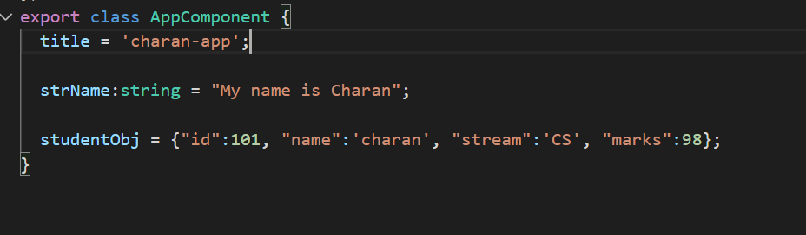
Ng-content
Content projection is a pattern in which you insert, or project, the content you want to use inside another component.
In App.component.ts

Slide 58
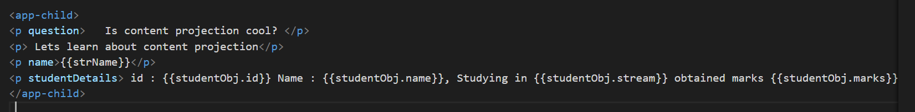
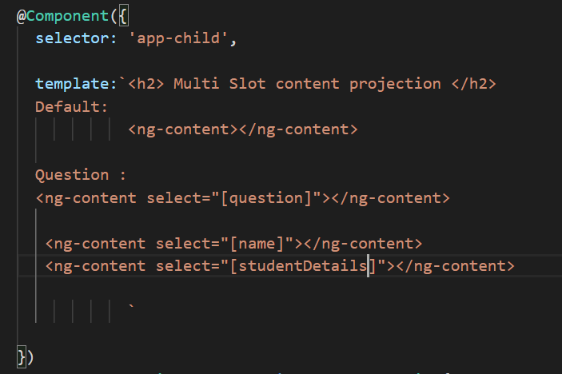
In App.component.html
In child.component.ts

Slide 59
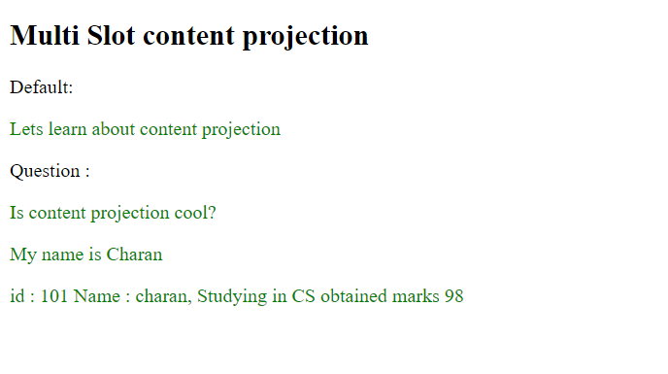
Output is:
1. First try with a simple string of ng-content.
2. Next, based on a tag.
3. Next, Display a variable content of app.component.ts, may be a string.
4. Next, create an object with 2 fieds and display.
5. Extend it to more fields and display the same.
Assignment : Insert an employee record with the fields, id, name, dept and designation.

Slide 60
Ng-container
ng-container allows us to create a division or section in a template without introducing a new HTML element. The ng-container does not render in the DOM, but content inside it is rendered. ng-container is not a directive, component, class, or interface, but just a syntax element.

Slide 61
ngTemplateOutlet
ngTemplateOutlet is a structural directive. We use it to insert a template (created by ngTemplate) in various sections of our DOM. For example, you can define a few templates to display an item and use them display at several places in the View and also swap that template as per the user’s choice.

Slide 62
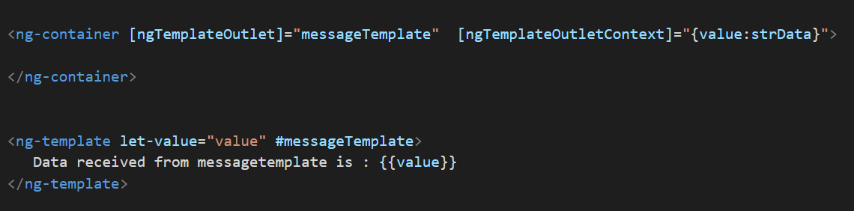
ngTemplateOutlet
Using ngTemplateoutlet a messageTemplate is defined and its value is passed to a variable named value. Using ng-template, a variable value is defined with the template messageTemplate and data received is also displayed.

Slide 63
@ViewChild
The ViewChild decorator is used to Query and get the reference of the DOM element in the Component.
One of the use cases of ViewChild is to get the reference of the Child Component in the Parent Component and manipulate its properties. This is one of the ways by which the Parent can communicate with the child components.

Slide 64
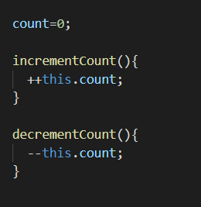
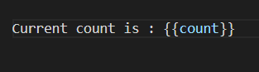
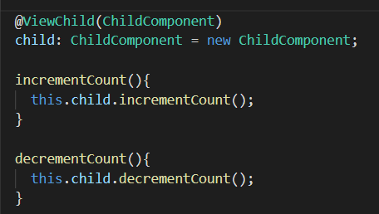
In ChildComponent.ts
In Child Component.html
In App.component.ts :

Slide 65
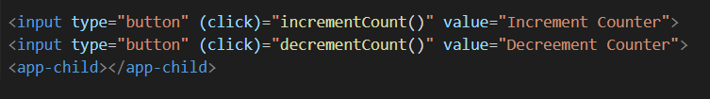
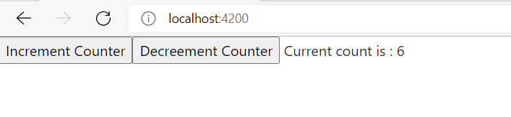
In App.component.html:

Slide 66
Data binding and interpolation
Interpolation
Interpolation is a technique that allows the user to bind a value to a UI element.
Interpolation binds the data one-way. This means that when value of the field bound using interpolation changes, it is updated in the page as well. It cannot change the value of the field.
Define a variable in app.component.ts and display the content of this variable in the app.component.html file as {{variable}}
To be demostrated:
First, show the number.
Then, a string value.
Then an object. studentObj = {“id”:102, “name”:”Charan”};

Slide 67
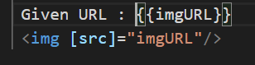
Property Binding.
Property binding in Angular helps you set values for properties of HTML elements or directives. Use property binding to do things such as toggle button functionality, set paths programmatically, and share values between components.
Define a variable in app.component.ts which defines the path of the image as:
Substitue the value of img src with imgURL in the app.component.html as in:
Here the Attributes of HTML will be placed in square brackets and variable of ts file is in double quotes.

Slide 68
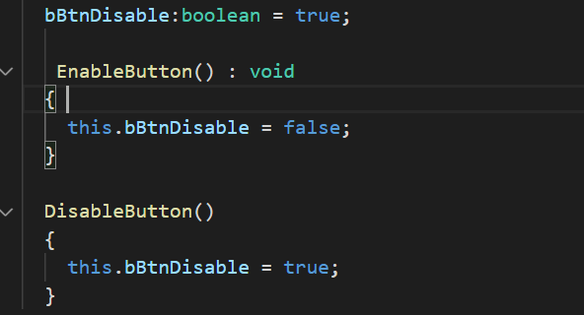
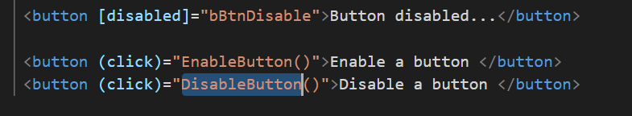
Property binding – Toggling buttons.
Define a property in app.component.ts to disable a button and also functions to enable and disable buttons based on property.
Display 3 buttons. (a) Button itself (b) To enable a button (c) To Disable a button. On click of enable and disable button, call function correspondingly.

Slide 69
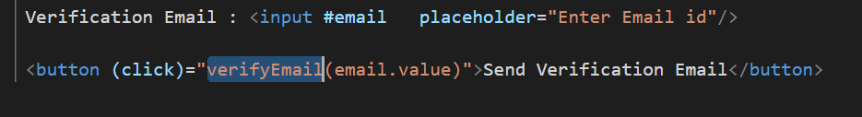
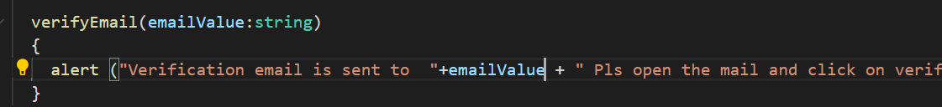
Template Reference
Template variables help you use data from one part of a template in another part of the template. Use template variables to perform tasks such as respond to user input or finely tune your application's forms.
Define a templat variable in app.component.html and use it in a button. On click of a button, perform the required operation.
In app.component.ts, write a function and perform the required operation.

Slide 70
Event binding
Event binding lets you listen for and respond to user actions such as keystrokes, mouse movements, clicks, and touches.

Slide 71
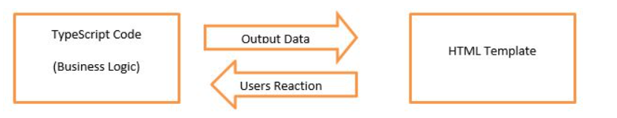
Two way data binding.
In two-way databinding, automatic synchronization of data happens between the Model and the View.
The ngmodel directive binds the value of HTML controls (input, select, textarea) to application data.

Slide 72
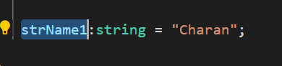
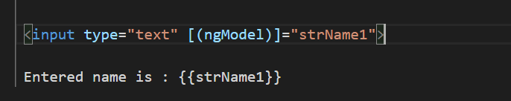
Add FormsModule in app.module.ts in both import section and imports section.
Create a new variable in app.component.ts.
Bind this variable with input control in app.component.html using ngModel.

Slide 73
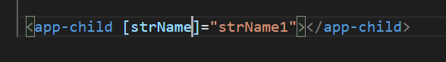
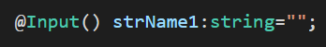
Custom Property Binding.
Using custom property binding to set the model property of a custom component is a great way for parent and child components to communicate.
@Input is used for communicating the data between Parent to Child.
Provide a Edit box in app.component.html and make it as two way data binding with app.component.ts file.
In the app.component.html, Send this variable to the child component as given below:
Import Input from @Angular/core as
import { Component, OnInit, Input } from '@angular/core';
Define the variable strName1 in child.component.ts as
Display strName1 in child.component.html as

Slide 74
Day-2

Slide 75
What is webpack
The dynamic web applications usually have lots of javascript files. These files are either created by you or it could be third party libraries like jquery/bootstrap etc. We include these in our index.html file using <script> tag. When a user sends requests to our application, the browser requests and loads these files one at a time. If you have lots of these files, then it will make your application slow. The solution to this problem is to merge all these files into a one or two files so that the browser can download the entire file in one request. This is where Webpack is used.
Webpack is a powerful module bundler, which scans your web application looking for javascript files and merges them into one ( or more) big file. Webpack has the ability to bundle any kind of file like JavaScript, CSS, SASS, LESS, images, HTML, & fonts etc.

Slide 76
Concepts of Webpack4
Entry: The entry point is simply a module or a JavatScript file (defaults to ./src/index.js) which webpack uses to start bundling. Webpack looks for the import statements in this module and builds the dependency graph of all the dependencies. If you don't use the default entry point i.e ./src/index.js, you need to specify it in the configuration file.
Output: Using the output point, you tell webpack the name and path of the file(s) where to produce the final bundle or set of bundles. By default it's ./dist/main.js for the main bundle and you can specify your custom values in the configuration file.
Loaders: Webpack makes use of loaders to know how to transform and bundle the other types of assets and files, such as CSS, images or TypeScript code, other than JavaScript and JSON which are supported by default.
Plugins: Webpack can be extended with plugins which are used for adding features that cant' be imlemented using loaders.
Mode: Webpack enables deveopers to specify different configuration options for development and production by using changing the mode parameter which can take either the development, production or none values. By default the mode is set to production.

Slide 77
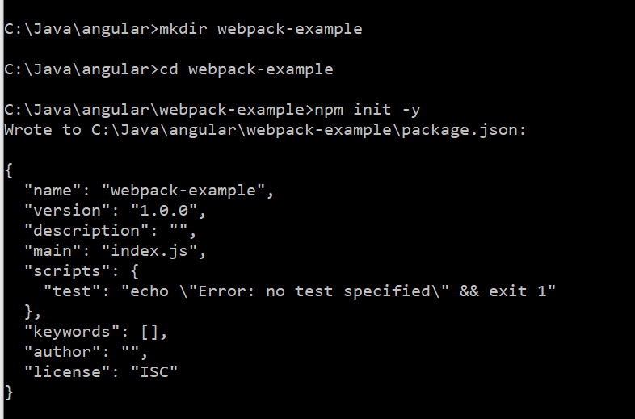
Example of webpack
Create a directory named webpack-example and switch to that directory and give the command npm init –y → this will create base version of package.json

Slide 78
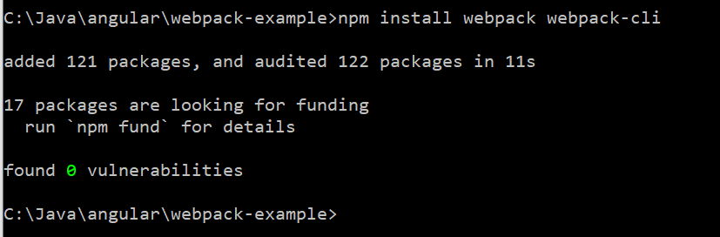
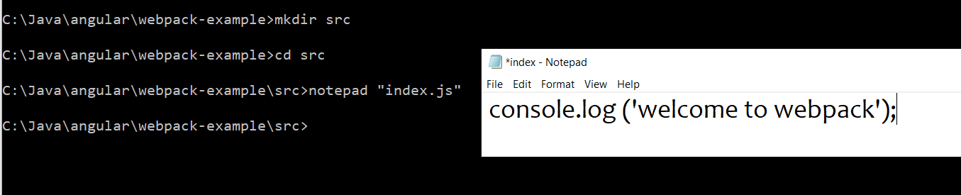
Install webpack and webpack-cli using the following command
Create src directory and write console.log in it.

Slide 79
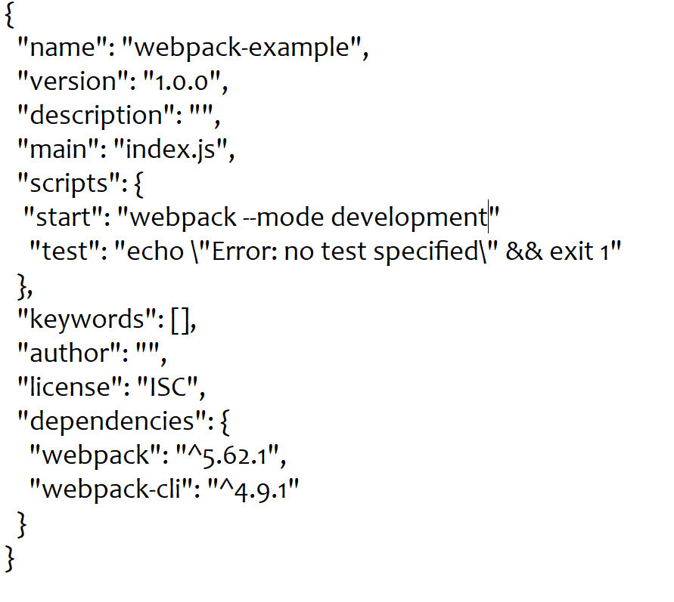
Add start option in package.json under scripts.

Slide 80
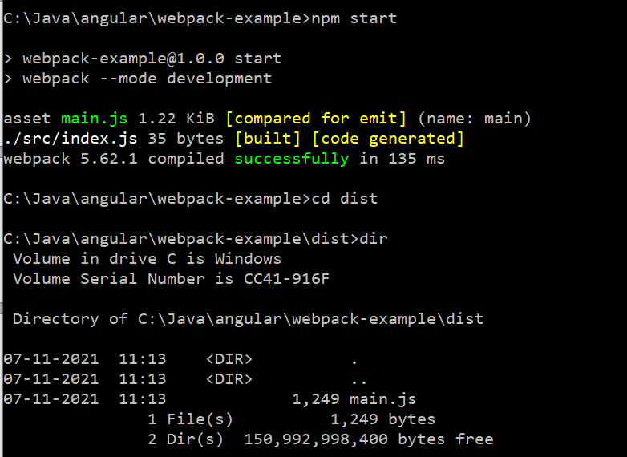
Use npm start to build the project and files will be placed in dist folder.

Slide 81
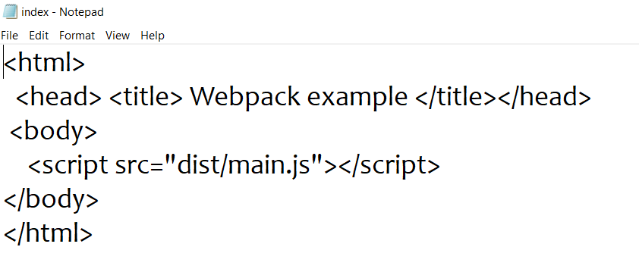
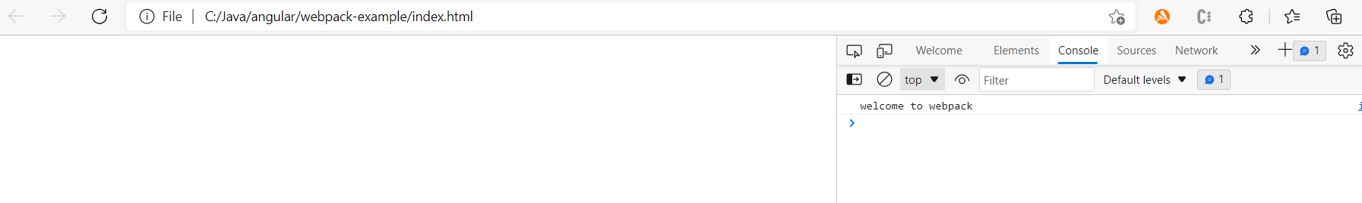
Create index.html and use main.js as the js file to execute.
Open index.html in the browser.

Slide 82

Add entry, output and plugins.
Add webpack.config.js and add the following code. entry will read from index.js, output will produce the files in dist directory and HtmlWebpackPlugin will create the required html file for execution.

Slide 83

Install html-webpack-plugin
Execute webpack –mode development and it gives the following output.
Execute index.html from dist directory and see the output in console.

Slide 84
Merge many files into a single file.
Install webpack-merge-include-globally
Install babel, required to merge all the files into one.

Slide 85


Modify webpack.configure.js as
Run webpack –mode development

Slide 86

Open the dist directory, you can see given js files are merged as vendor.js and gives css files merged as vendor.css
Open the contents of vendor.js and vendor.css, they are all merged files of given files in webpack.configures.js.

Slide 87
Directives
Directives are classes that add additional behavior to elements in your Angular applications.
Type of directives:
Attribute directives—directives that change the appearance or behavior of an element, component, or another directive.
Structural directives—directives that change the DOM layout by adding and removing DOM elements.

Slide 88
Attribute Directives
NgClass—adds and removes a set of CSS classes.
NgStyle—adds and removes a set of HTML styles.
NgModel—adds two-way data binding to an HTML form element.
Structural Directive: Structural directives are responsible for HTML layout. They shape or reshape the DOM's structure, typically by adding, removing, and manipulating the host elements to which they are attached. Structural directives are:
NgIf—conditionally creates or disposes of subviews from the template.
NgFor—repeat a node for each item in a list.
NgSwitch—a set of directives that switch among alternative views.

Slide 89

Install bootstrap in Angular.
Give the following commands to install bootstrap for angular.
npm install bootstrap
npm install jquery
After the installation, modify the angular.json with the following.
And then give ngserve and start angular server.

Slide 90
Test whether boostrap is installed or not.
Add the following app.component.html
<button [ngClass]="btn btn-primary'" type="submit" (click)='OnSubmit()'>Submit</button>
.and in app.component.ts
OnSubmit() {alert (“Submit button is clicked”);}

Slide 91

ngClass
Single class can be set like this.
<button [ngClass]=“’btn btn-primary'" type="submit" (click)='OnSubmit()'>Submit</button>
This will set the button to btn-primary in angular. Output wll be like this →

Slide 92

ngClass with multiple Strings.
Setting the multiple clasess.
Define a class in styles.css as:
.md-button {
padding: 0 6px 0 6px;
margin: 16px 18px 16px 28px;
font-size: 24px;
text-align: center;
text-transform: uppercase;
}
In app.component.html, define the multiple classes as an array of strings as given below:
<button [ngClass]="['btn btn-primary', 'md-button']" type="submit" (click)='OnSubmit()'>Submit</button>
Output will be like this :

Slide 93


Adding a condtion in ngClass.
In styles.css
In app.component.html →

Slide 94



In app.component.s →
Output will be

Slide 95
ngStyle
Changes the style of the HTML elements.
In app.component.ts, declare a variable strColor as
In app.component.html, modify the style of the component dynamically as
With this, as and when the user enters the color name, color of the text is modified.

Slide 96


Multiple attributes in ngStyle.
Define 2 variables to change the color and font-size of the text in
app.component.ts
In app.component.html, take the input from two edit boxes and apply them to ngStyle dynamically.
Output will be like this:

Slide 97


Conditioning in ngStyle.
Add an attribute in app.component.ts
In styles.css add the following:
In app.component.html
If the user types Yes in the edit box then background color of the text is changed to green else it is changed to Red.

Slide 98



ngFor Directive
NgFor is a built-in template directive that makes it easy to iterate over something like an array or an object or array of objects.
Create an array of objects in app.component.ts as
Add the following code in app.component.html,
which iterates every element of the list and displays the names. And
output will be like this

Slide 99


Display in a table using ngFor.
In app.component.ts, define array of objets →
In app.component.html, iterate the array of objects and display them in a table.

Slide 100


*ngIf
ngIf is used for conditinal rendering.
Based on a condition, lets display the text on the browser.
In the app.component.ts
In app.component.html, add the following code:

Slide 101




ngIf for toggling
In app.component.ts, define a variable
In app.component.html →
Output will be :

Slide 102




*ngIf for displaying Login or register button.
In app.component.ts
In App.component.html →
Output is:

Slide 103
ngSwitch.
Based on strData, its corresponding case is selected and displayed.
<input type="text" [(ngModel)]="strData">
<div [ngSwitch]="strData">
<div *ngSwitchCase="1">One</div>
<div *ngSwitchCase="2">Two</div>
<div *ngSwitchCase="3">Three</div>
<div *ngSwitchCase="4">Four</div>
<div *ngSwitchCase="5">Five</div>
<div *ngSwitchDefault>This is default...</div>
</div>

Slide 104


Custom Attribute Directive
We can define our own attribute directives.
Generate a directive as given below:
In App.component.html

Slide 105

In HighLight.directive.ts
The HostBinding & HostListener are decorators in Angular. HostListener listens to host events, while HostBinding allows us to bind to a property of the host element. The host is an element on which we attach our component or directive.

Slide 106


On Mouse hovering on the text, text color and font size is changed due to HighLIght directive.

Slide 107



@HostBinding.
1. Create a directive named Rainbow.
In App.component.html
In App.component.css

Slide 108

In RainbowDirective.ts

Slide 109


Slide 110

Custom Structural Directive.
Create a directive with the following command:

Slide 111

Loop Directive.ts

Slide 112


In app.component.html

Slide 113

Angular Life Cycle Hooks.

Slide 114
constructor
This is invoked when Angular creates a component or directive by calling new on the class.
ngOnChanges
Invoked every time there is a change in one of th input properties of the component.
ngOnInit
Invoked when given component has been initialized.
This hook is only called once after the first ngOnChanges
ngDoCheck
Invoked when the change detector of the given component is invoked. It allows us to implement our own change detection algorithm for the given component.
ngOnDestroy
This method will be invoked just before Angular destroys the component.
Use this hook to unsubscribe observables and detach event handlers to avoid memory leaks.

Slide 115
Hooks for the Component’s Children
ngAfterContentInit
Invoked after Angular performs any content projection into the component’s view (see the previous lecture on Content Projection for more info).
ngAfterContentChecked
Invoked each time the content of the given component has been checked by the change detection mechanism of Angular.
ngAfterViewInit
Invoked when the component’s view has been fully initialized.
ngAfterViewChecked
Invoked each time the view of the given component has been checked by the change detection mechanism of Angular.

Slide 116
Day-3

Slide 117
Pipes, what is a pipe.
Pipes are a useful feature in Angular. They are a simple way to transform values in an Angular template. There are some built in pipes, but you can also build your own pipes.
A pipe takes in a value or values and then returns a value. This is great for simple transformations on data but it can also be used in other unique ways

Slide 118
Built in pipes.
Following are the built in pipes
1. Lowercase Pipe.
2. Uppercase Pipe
3. DatePipe
4. CurrencyPipe.
5. JsonPipe
6. PercentPipe.
7. DecimalPipe.
8. SlicePipe.
9. Async Pipe

Slide 119


Uppercae and Lowercase pipes.
Define a variable strToConvert in app.component.ts and in app.component.html
Output will be:

Slide 120


Currency Pipe.
Create a variable iCurrencyData in app.component.ts and use it in currency Pipe as given below:
Output will be like this:
After USD : “US Dollar is mentioned. That string
will be displayed. When ‘code’ is given, country
code will be displayed as EUR.

Slide 121


Date pipe.
Define these variables in app.component.ts.
Display date using date pipe with various formats.

Slide 122

Output of date pipe

Slide 123


JSON pipe
Json pipe displays content of json object.
Define json object and array of json objects in app.component.ts
Display them using json pipe in app.component.html

Slide 124
Output of Json pipe code

Slide 125



Decimal Pipe
Define a variable in the app.component.ts
Display original value and its decimal format value in app.component.html
Output is

Slide 126



Percent Pipe
Angular PercentPipe is an angular Pipe API that formats a number as a percentage.
Define a variable in app.component.ts as:
Show the percent using percent pipe in app.component.html
Format is {minIntegerDigits}.{minFractionDigits}-{maxFractionDigits}
Output :

Slide 127



Slice Pipe.
Slices the string using slice pipe.
Define a string in app.component.ts as
Define various types slices in app.component.html
Output is

Slide 128
Assignment – 12 & 13
12. Create three edit boxes. First edit box when take the string from the user. Second and third edit boxes will take starting and ending number for slice. If the first edit box takes string as "Munnar" and second and third edit box takes 2 numbers as 1 and -1 then it should display "unna" as the output.
13. Modify the above program as if the second input is zero then second input should not be considered. If the second input is 0 then the command should be
string | slice:startData. Hint: You can use *ngIf, else and ng-template directives.
<input type="text" [(ngModel)]="strForSlicePipe">
<input type="number" [(ngModel)]="iStartData">
<input type="number" [(ngModel)]="iEndData">
Original Data : {{strForSlicePipe}} <br>
<div *ngIf='iEndData != 0; else zeroBlock'>
Sliced data 2:5 (2nd char to 5th Char): {{strForSlicePipe |slice:iStartData:iEndData }}<br>
</div>
<ng-template #zeroBlock>
Sliced data 2:5 (2nd char to 5th Char): {{strForSlicePipe |slice:iStartData}}
</ng-template>

Slide 129


Creating a custom pipe
Generate a new pipe from command line as given below:
Add the following code in temp-converter.pipe.ts, modify unknown to the data type we require

Slide 130



Add two variables in app.component.ts →
Add the code in app.component.html as
Output of this code is :
Demo for Uppercase of a
given string using custom
pipe.

Slide 131


Creating a filter pipe
Generate a new pipe from command line as given below:
Add the following code in filter.pipe.ts, modify unknown to the data type we require

Slide 132


Creating a filter pipe
Create a new file named User.ts
In App.component.ts

Slide 133

Creating a filter pipe
In App.component.html

Slide 134


Creating a filter pipe

Slide 135
Pure vs Impure pipes.
Pipe can be made pure or impre with a flag in the pipe.ts as “pure:true/false”. If the pure flag is true then it is pure pipe else it is impure pipe.
What is pure pipe or Impure Pipe.
Whenever the state of the component is modified then pipe is executed is called Impure Pipe. Pure pipe is executed only when it is called.

Slide 136


Let us take an example of displaying a table based on array of objets as shown below:
A pipe is developed to filter based on the First name as below:

Slide 137

App.component.ts is adding records to the array as show below:

Slide 138

App.component.html displays the content of array of objects using nfFor with filter.

Slide 139


On filtering, it shows like this:
Lets say we add two button in the html as shown below:

Slide 140

Functions of these buttons are:
On click of AddUser button will not have an impact on pipe as it is not called after the change in the state of the object. This is called pupre pipe. This behavior can be modified by changing the pipe to impure pipe, that is, adding a flag pure:false in the pipe.ts file. But Impure pipes are called everytime there is change in the state of the component, hence there is an performance impact.
There is an error created in the pipe, lets see if you can resolve it.
Reset() needs to be looked into. You need to correct them to make it work.

Slide 141

Pure vs Impure
Create two pipes named purePipe and ImpurePipe.
Ng g pipe purepipe --skip-tests
Ng g pipe impurepipe --skip-tests
Content of pupre pipe :

Slide 142



Content of Impure Pipe is
Define two variables in app.component.ts
Use the pipe in html as shown:

Slide 143

Open console to see how exactly both the pipes are behaving:
Pupre pipe is called whenever it is invoked but impure pipe is called whenever the state of the object is modified. Here the component is modified internally.

Slide 144
Observables.
Promises are same as discussed in typescript.
Observables provide support for passing messages between parts of your application. They are used frequently in Angular and are a technique for event handling, asynchronous programming, and handling multiple values.
The observer pattern is a software design pattern in which an object, called the subject, maintains a list of its dependents, called observers, and notifies them automatically of state changes. This pattern is similar (but not identical) to the publish/subscribe design pattern.
Observables are declarative—that is, you define a function for publishing values, but it is not executed until a consumer subscribes to it. The subscribed consumer then receives notifications until the function completes, or until they unsubscribe.
An observable can deliver multiple values of any type—literals, messages, or events, depending on the context. The API for receiving values is the same whether the values are delivered synchronously or asynchronously. Because setup and teardown logic are both handled by the observable, your application code only needs to worry about subscribing to consume values, and when done, unsubscribing. Whether the stream was keystrokes, an HTTP response, or an interval timer, the interface for listening to values and stopping listening is the same.
Because of these advantages, observables are used extensively within Angular, and for application development as well.
A program will be demonstrated during Forms module.

Slide 145
Async Pipe
The async pipe in angular will subscribe to an Observable or Promise and return the latest value it has emitted. Whenever a new value is emitted from an Observable or Promise, the async pipe marks the component to be checked for changes. When the component gets destroyed, the async pipe unsubscribes automatically to avoid potential memory leaks. We can use the async pipe in Angular application by including the CommonModule which exports all the basic Angular directives and pipes, such as NgIf, NgForOf, DecimalPipe, and so on. These are then re-exported by BrowserModule, which is included automatically in the root AppModule, when you create a new app with the CLI new command.

Slide 146



Async Pipe
In App.component.ts
In App.component.html
Whenever the time is modified in observable, it is displayed and updated on html. Async works all the time when the data is modified using observables.

Slide 147
Day-4

Slide 148
Angular Service
Introduction to services and dependency injection.
Service is a broad category encompassing any value, function, or feature that an application needs. A service is typically a class with a narrow, well-defined purpose. It should do something specific and do it well.
Angular distinguishes components from services to increase modularity and reusability. By separating a component's view-related functionality from other kinds of processing, you can make your component classes lean and efficient.
Ideally, a component's job is to enable the user experience and nothing more. A component should present properties and methods for data binding, in order to mediate between the view (rendered by the template) and the application logic (which often includes some notion of a model).
A component can delegate certain tasks to services, such as fetching data from the server, validating user input, or logging directly to the console. By defining such processing tasks in an injectable service class, you make those tasks available to any component. You can also make your application more adaptable by injecting different providers of the same kind of service, as appropriate in different circumstances.
Angular doesn't enforce these principles. Angular does help you follow these principles by making it easy to factor your application logic into services and make those services available to components through dependency injection.

Slide 149
Hierarchical Injector
Hierarchical Injector
The Angular’s root or centralized injector is a hierarchical injector, which is one of its most exciting features.
It means if we provide a service for one module or component, the instance of that service will be available to all the descendants of that module or component. In an Angular application, there are multiple places where we can “provide” a service:

Slide 150
Http Service
Http Service will help us fetch external data, post to it, etc. We need to import the http module to make use of the http service.
Import it in app.module.ts
import { HttpModule } from '@angular/http';

Slide 151
Dependency Injection.
Dependencies are services or objects that a class needs to perform its function. Dependency injection, or DI, is a design pattern in which a class requests dependencies from external sources rather than creating them.
Angular's DI framework provides dependencies to a class upon instantiation. Use Angular DI to increase flexibility and modularity in your applications.
Dependency Injection (DI) is a technique in which a class receives its dependencies from external sources rather than creating them itself.

Slide 152
Which portion of the code is better
Objeserve the following code.
I. public class TextEditor {
private SpellChecker spellChecker;
public TextEditor() {
spellChecker = new SpellChecker(); }}
Observe the following code and tell which is beneficial compared to both.
II. public class TextEditor {
private SpellChecker spellChecker;
public TextEditor(SpellChecker spellChecker) {
this.spellChecker = spellChecker; }}

Slide 153
Benefits of Dependency Injection.
loosely coupled
Easier to Test
Reusing the Component
Angular Depedency Framework:
Consumer
The Consumer is the class (Component, Directive, or Service) that needs the Dependency. In the above example, the AppComponent is the Consumer.
Dependency
The Service that we want to in our consumer. In the above example the ProductService is the Dependency

Slide 154

Creating a service.
From the command line, generate the service using
ng g service Product → It will create the file Product.service.ts.
Create Product.ts as given below:

Slide 155

ProductService is having one function which returns the list of products. All the related functionalities of Product can be written in ProductService. Then components can make use of these services as libraries without rewriting them.

Slide 156


In App.component.ts
In app.component.html →

Slide 157

Output of Service.

Slide 158
Injector.
The Angular Injector is responsible for instantiating the dependency and injecting it into the component or service.
The Injector we are using is a Module Injector. That means this injector is injected in the root module which is ngModule.
The ModuleInjector can be configured in one of two ways:
Using the @Injectable() providedIn property to refer to @NgModule(), or root. → This is in the service.ts file.
Using the @NgModule() providers array. → This is another way of injecting the service in the module. Previous way of injecting the service can be removed and name of the service can be added in the providers array at @NgModule() in app.module.ts file.

Slide 159


Creating a Logging Service.
Create a Logger service with the command:
Add the function log in LoggerService.ts:

Slide 160

Add the following code in app.component.ts
Click on the button to fetch the records from the service and check the console log. Output in the console log is:

Slide 161

EventEmitter.
Event Emitter emits the data.
In child.component.ts →
In child.component.html → On every keystroke, one function is called and that emits the entered data to the parent.

Slide 162



In app.component.html →
In app.component.ts →
Output is :

Slide 163
BrowserModule and CommonModule
BrowserModule – The browser module is imported from @angular/platform-browser and it is used when you want to run your application in a browser.
CommonModule – The common module is imported from @angular/common and it is used when you want to use directives - NgIf, NgFor and so on.

Slide 164
Angular Module Vs Javascript Module
A JavaScript module is an individual file with JavaScript code, usually containing a class or a library of functions for a specific purpose within your application. JavaScript modules let you spread your work across multiple files.
An NgModule is a class marked by the @NgModule decorator with a metadata object that describes how that particular part of the application fits together with the other parts. NgModules are specific to Angular. While classes with an @NgModule decorator are by convention kept in their own files, they differ from JavaScript modules because they include this metadata.
The @NgModule metadata plays an important role in guiding the Angular compilation process that converts the application code you write into highly performant JavaScript code. The metadata describes how to compile a component's template and how to create an injector at runtime. It identifies the NgModule's components, directives, and pipes, and makes some of them public through the exports property so that external components can use them. You can also use an NgModule to add providers for services, so that the services are available elsewhere in your application.

Slide 165
Angular Module Vs Javascript Module
The root NgModule starts with import statements to import JavaScript modules. It then configures the @NgModule with the following arrays:
declarations: The components, directives, and pipes that belong to the NgModule. A new application project's root NgModule has only one component, called AppComponent.
imports: Other NgModules you are using, so that you can use their declarables. The newly generated root NgModule imports BrowserModule in order to use browser-specific services such as DOM rendering, sanitization, and location.
providers: Providers of services that components in other NgModules can use. There are no providers in a newly generated root NgModule.
bootstrap: The entry component that Angular creates and inserts into the index.html host web page, thereby bootstrapping the application. This entry component, AppComponent, appears in both the declarations and the bootstrap arrays.

Slide 166
Exporting from a module
An export what you put is the exports property of the @NgModule decorator. It enables an Angular module to expose some of its components/directives/pipes to the other modules in the applications. Without it, the components/directives/pipes defined in a module could only be used in that module.

Slide 167
Angular Libraries
Many applications need to solve the same general problems, such as presenting a unified user interface, presenting data, and allowing data entry. Developers can create general solutions for particular domains that can be adapted for re-use in different applications. Such a solution can be built as Angular libraries.
Angular Material is an example of a large, general-purpose library that provides sophisticated, reusable, and adaptable UI components.

Slide 168

How to launch an application.
Make the build with the command ng build.
This will create the dist directory in that project name directory is created and required files are created along with index.html.
User needs to execute index.html. All the dependent files are created in this directory only. To say index.html that all the dependent files are there from this directory, we need to specify –base-href ./

Slide 169
AOT
Just in time compiler provides compilation during the execution of the program at a run time before execution. In simple words, code get compiles when it’s needed, not at the build time.
Just in time compiler compiles each file separately and it’s compiled in the browser. You don’t have to build your project again after changing your code.
Most compiling is done on the browser side, so it is time consuming. To improve the performance of Angular, AOT is introduced which stands for Ahead Of Time compiler.
The Angular ahead-of-time (AOT) compiler converts your Angular HTML and TypeScript code into efficient JavaScript code during the build phase before the browser downloads and runs that code. Compiling your application during the build process provides a faster rendering in the browser.

Slide 170
AOT
Features of AOT :
Faster rendering : With AOT, the browser downloads a pre-compiled version of the application. The browser loads executable code so it can render the application immediately, without waiting to compile the application first.
Fewer asynchronous requests : The compiler inlines external HTML templates and CSS style sheets within the application JavaScript, eliminating separate ajax requests for those source files.
Smaller Angular framework download size : There's no need to download the Angular compiler if the application is already compiled. The compiler is roughly half of Angular itself, so omitting it dramatically reduces the application payload.
Detect template errors earlier : The AOT compiler detects and reports template binding errors during the build step before users can see them.
Better security : AOT compiles HTML templates and components into JavaScript files long before they are served to the client. With no templates to read and no risky client-side HTML or JavaScript evaluation, there are fewer opportunities for injection attacks.

Slide 171
AOT
Choosing a compiler :
Just-in-Time (JIT) : Compiles your application in the browser at runtime. This was the default until Angular 8.
Ahead-of-Time (AOT) : Compiles your application and libraries at build time. This is the default starting in Angular 9.
When you run the ng build (build only) or ng serve (build and serve locally) CLI commands, the type of compilation (JIT or AOT) depends on the value of the aot property in your build configuration specified in angular.json. By default, aot is set to true for new CLI applications.

Slide 172

Create a new module
Create a new module and a component under that module with the following commands:

Slide 173


Student.module.ts is created and it will be like this:
Student component is created under student module and a function is created to return a name.

Slide 174


Include StudentModule in imports section in the AppModule as shown below:
Import StudentComponent in app.component.ts and use the function of StudentComponent as:
Include this code on click of a button

Slide 175

Output of the code in the console..

Slide 176
Day-5

Slide 177
What are Angular forms.
Handling user input with forms is the cornerstone of many common applications. Applications use forms to enable users to log in, to update a profile, to enter sensitive information, and to perform many other data-entry tasks.
Angular provides two different approaches to handling user input through forms: reactive and template-driven. Both capture user input events from the view, validate the user input, create a form model and data model to update, and provide a way to track changes.

Slide 178
Template driven form.
Template-driven forms in Angular are forms that are built and managed directly in the HTML template. They rely on Angular directives to bind form controls to data models in the component. The form controls and validation rules are defined declaratively in the template (HTML), and Angular automatically creates the form model behind the scenes.
Forms are defined primarily in the HTML template.
You use Angular directives like ngModel, ngForm, and ngSubmit to create and manage the form.
Two-Way Data Binding:
Template-driven forms use Angular's [(ngModel)] directive to create two-way data binding between the form controls and the component's data model. This means that changes in the form input update the component model automatically, and vice versa.

Slide 179




Template driven form.

Slide 180

Template driven form with validation.

Slide 181
<!-- Template driven form with validation... -->
<form #loginForm="ngForm" (ngSubmit)="onSubmit(loginForm)">
User ID : <input type="text" name="userId" ngModel #uid="ngModel" required minlength="5"> <br /> <br />
<div *ngIf="uid?.invalid && (uid?.dirty || uid?.touched)">
<div *ngIf="uid?.errors?.['required']">
<p class="error"> User ID should not be empty...</p>
</div>
<div *ngIf="uid?.errors?.['minlength']">
<p class="error"> User ID should be atleast 5 characters...</p>
</div>
</div>
Password : <input type="text" name="pwd" #uid="ngModel" ngModel #pwd="ngModel" required minlength="5"> <br /><br />
<div *ngIf="pwd?.invalid && (pwd?.dirty || pwd?.touched)">
<div *ngIf="pwd?.errors?.['required']">
<p class="error"> Password should not be empty...</p>
</div>
<div *ngIf="pwd?.errors?.['minlength']">
<p class="error"> Password should be atleast 5 characters...</p>
</div>
</div>
<button class="btn btn-success" type="submit">Login</button>
</form>

Slide 182


Template driven form with validation.

Slide 183
What is a Reactive Form.
At face value, a reactive form appears to be similar to a template-driven form. It does require you to import a different module into your application, though.
The component’s template is much cleaner, focusing solely on presentation logic. For more extensive forms, having many directives in the template for specifying business validation rules can quickly become complex. Thus, implementing that logic on the component class instead is much clearer.
All of the form fields’ business validation criteria have been relocated to the component class, where they can be unit tested much more easily.
Moving the form model specification to the component makes it much easier to define the form dynamically if necessary. For example, it could be based on backend data, making more advanced use cases easier to implement.
It’s also a lot easier to develop a custom validator with reactive forms. All we have to do is define a function and put it into our setup. To get the same functionality with template-driven forms, we must also construct a custom directive. This is a bit more complicated than simply writing a function.
The reactive forms module allows us to build the form model programmatically rather than declaratively via the view. And there are some extra benefits when you can do this when compared to template forms.

Slide 184

Registering input form controls to Angular.
Add ReactiveFormsModuel in Imports section of app.module.ts
Import FormGroup, FormControl and Validators in app.component.ts

Slide 185


Define FormGroup and add controls in it using FormControls in app.component.ts. On Submit, we are retreiving the values of uid and pwd and setting the value of pwd to admin123.
Connect html form and model (ts) file as given below. Specify the formGroup and formControlName in the form.

Slide 186

Output of the form is :

Slide 187


Reactive Forms validator.
In app.component.ts, add required and minLength validator of validator framework while creating the control in FormControl.
Required by the validator framework in the html to obtain the value of the uid.

Slide 188
Dirty & touched
Apart from checking valid we are also checking for the dirty & touched. Because we do not want the application to display the error when the form is displayed for the first time. We want to display errors only after the user has attempted to change the value. The dirty & touched properties help us do that.
dirty: A control is dirty if the user has changed the value in the UI. touched: A control is touched if the user has triggered a blur event on it.
First, we need to disable browser validator by adding the novalidate attribute to the <form> element as shown below. If this attribute is present then the form is not validated by the built-in HTML5 validation when submitted.

Slide 189


In app.component.html
Output is:

Slide 190
Another example of custom validation.
In App.component.ts
heroForm!:FormGroup;
ngOnInit(){
this.getAllUsersFromRestService();
this.heroForm = new FormGroup({
uidReactive: new FormControl('Charan', [Validators.required, Validators.minLength(4)]),
pwdReactive: new FormControl('Admin', [Validators.required, Validators.minLength(4)])
});
}
get uidReactive() { return this.heroForm.get('uidReactive'); }
get pwdReactive() { return this.heroForm.get('pwdReactive'); }

Slide 191
In App.component.html
<form [formGroup]="heroForm">
<input type="text" id="uidReactive" formControlName="uidReactive"> <br/> <br/>
<div *ngIf="uidReactive?.invalid && (uidReactive?.dirty || uidReactive?.touched)" >
<div *ngIf="uidReactive?.errors?.['required']"> <h4> User ID is required. </h4> </div>
<div *ngIf="uidReactive?.errors?.['minlength']"> <h4> User ID must be at least 4 characters long. </h4> </div>
</div>
<input type="text" id="pwdReactive" formControlName="pwdReactive"> <br/> <br/>
<div *ngIf="pwdReactive?.invalid && (pwdReactive?.dirty || pwdReactive?.touched)" >
<div *ngIf="pwdReactive?.errors?.['required']"> <h4> Password is required. </h4> </div>
<div *ngIf="pwdReactive?.errors?.['minlength']"> <h4> Passwored must be at least 4 characters long. </h4> </div>
</div>
<button class="btn btn-success" (click)="loginForm1()" > Login </button>
</form>

Slide 192



Slide 193

Reactive Forms Custom Validatoin.
1. Create a file named PasswordValidator.ts and add the following code:

Slide 194

2. In app.component.ts

Slide 195

2. In app.component.html

Slide 196


Slide 197
Form States and CSS States
Input fields have the following states:
untouched The field has not been touched yet
touched The field has been touched
pristine The field has not been modified yet
dirty The field has been modified
invalid The field content is not valid
valid The field content is valid
They are all properties of the input field, and are either true or false.
Forms have the following states:
pristine No fields have been modified yet
dirty One or more have been modified
invalid The form content is not valid
valid The form content is valid
submitted The form is submitted

Slide 198
Form States and CSS States
Input fields have the following states:
untouched The field has not been touched yet
touched The field has been touched
pristine The field has not been modified yet
dirty The field has been modified
invalid The field content is not valid
valid The field content is valid
They are all properties of the input field, and are either true or false.
Forms have the following states:
pristine No fields have been modified yet
dirty One or more have been modified
invalid The form content is not valid
valid The form content is valid
submitted The form is submitted

Slide 199

ngModelGroup.
The NgModelGroup is used to create a top-level form group Instance, and it binds the form to the given form value.
In app.component.ts

Slide 200


In app.component.html
Output is :

Slide 201
RESTful services
RESTful web services are built to work best on the Web. Representational State Transfer (REST) is an architectural style that specifies constraints, such as the uniform interface, that if applied to a web service induce desirable properties, such as performance, scalability, and modifiability, that enable services to work best on the Web.

Slide 202

Install json server
With npm install –g json-server in the command line will install the json server.

Slide 203

Create db.json
Creat db.json in the location of package.json.

Slide 204

Start the json server

Slide 205

Asynchronous Response Handling
The Asynchronous Response Handler pattern addresses the problem of blocking on the client thread that calls a service. It enables clients to do other things once the request has been sent.

Slide 206
RxJS
RxJS stands for *R*eactive E*x*tensions for *J*ava*S*cript, and it’s a library that gives us an implementation of Observables for JavaScript.

Slide 207
Angular Http Service.
The HttpClient is used to perform HTTP requests and it imported form @angular/common/http.
The HttpClient is more modern and easy to use the alternative of HTTP Service.
HttpClient is an improved replacement for Http Service. They expect to deprecate Http in Angular 5 and remove it in a later version.
To use http get/put/post delete methods from Angular, we need to create the object of HttpClient in Depedence Injection mode.

Slide 208
Observable<Response> object
Observables provide support for passing messages between parts of your application. They are used frequently in Angular and are a technique for event handling, asynchronous programming, and handling multiple values.
The observer pattern is a software design pattern in which an object, called the subject, maintains a list of its dependents, called observers, and notifies them automatically of state changes.
Observable is a function that converts the ordinary stream of data into an observable stream of data. You can think of Observable as a wrapper around the ordinary stream of data.
Observable stream or simple Observable emits the value from the stream asynchronously. It emits the complete signals when the stream completes or an error signal if the stream errors out.
Observables are declarative. You define an observable function just like any other variable. The observable starts to emit values only when someone subscribes to it.

Slide 209

Create User class

Slide 210

Add HttpClientModule in app.module.ts

Slide 211

RestService
Generate a new service for RestService → ng g service Rest

Slide 212

RestService.

Slide 213


App.component.ts

Slide 214

In App.component.html

Slide 215
Day - 6

Slide 216
What is a router
Angular Router is a powerful JavaScript router built and maintained by the Angular core team that can be installed from the @angular/router package. It provides a complete routing library with the possibility to have multiple router outlets, different path matching strategies, easy access to route parameters and route guards to protect components from unauthorized access.
The Angular router is a core part of the Angular platform. It enables developers to build Single Page Applications with multiple views and allow navigation between these views.

Slide 217
Router
The Angular Router is an object that enables navigation from one component to the next component as users perform application tasks like clicking on menus links, buttons or clicking on back/forward button on the browser. We can access the router object and use its methods like navigate() or navigateByUrl(), to navigate to a route
Route
Route tells the Angular Router which view to display when a user clicks a link or pastes a URL into the browser address bar. Every Route consists of a path and a component it is mapped to. The Router object parses and builds the final URL using the Route
Routes
Routes is an array of Route objects our application supports
RouterOutlet
The outerOutlet is a directive (<router-outlet>) that serves as a placeholder, where the Router should display the view

Slide 218
RouterLink
The RouterLink is a directive that binds the HTML element to a Route. Clicking on the HTML element, which is bound to a RouterLink, will result in navigation to the Route. The RouterLink may contain parameters to be passed to the route’s component.
RouterLinkActive
RouterLinkActive is a directive for adding or removing classes from an HTML element that is bound to a RouterLink. Using this directive, we can toggle CSS classes for active RouterLinks based on the current RouterState
ActivatedRoute
The ActivatedRoute is an object that represents the currently activated route associated with the loaded Component.

Slide 219
Navigation
Navigation is one of the important aspect in a web application. Even though a single page application (SPA) does not have multiple page concept, it does moves from one view to another view Providing clear and understandable navigation elements decides the success of an application.
Angular provides extensive set of navigation feature to accommodate simple scenario to complex scenario. The process of defining navigation element and the corresponding view is called Routing. Angular provides a separate module, RouterModule to set up the navigation in the Angular application.

Slide 220
URL Entry
A router will have the links and when a link is clicked on, it will choose a path and that path is pointed by a component. That means when a link is clicked on control is routed to a specific component.

Slide 221
Creating the router
Generate the required components as in (a) About (b)Contact Us (c) Products (d) NoPageFound. → use ng g c for all these components.
Add in app-routing-module.ts

Slide 222

Add entries in app-routing.module.ts
Add path entries to app-routing.modules.ts and right now, ignore canActivate. This is for canActivate Guard. Exports is exporting this router for the whole application.

Slide 223


Code to app the router links in app.component.html

Slide 224

Code in app.component.ts

Slide 225

Code in ProductService.ts

Slide 226

Code in product.component.ts

Slide 227

Code in product.component.ts

Slide 228

Code in product.component.ts

Slide 229

Code in product.component.html

Slide 230

Create No Page Found component and have the following code in nopagefound.component.html. It will be called when the given URL in the browser is not part of given routes in app-routes.component.ts

Slide 231

For Query params, create a component users-display and add the following code. In query params, we can send any number of params and if there are 5 params defined, we can send 2 or 3 or 4 or 5. For the sent params, data will go for the rest undefined will be there.

Slide 232

Create a service named AuthenticationService (ng g service AuthicationService). This will check whether the user has given the right user id and password or not.

Slide 233

Create AuthGuardService by ng g service AuthGuard.
Add the following code in authguard.service.ts

Slide 234

Output

Slide 235
Other guards.
Other route guards other than CanActivate are :
1. CanActivateChild
2. CanDeactivate
3. CanLoad
4. Resolver.
CanActivateChild : CanActivateChild is almost similar to CanActivate interface, the only difference is CanActivate is used to control the accessibility of the current route but CanActivateChild is used to prevent access to child routes of a given route, so by using this you don’t need to add canActive on each child route, in other words, you just need to add canActiveChild to parent route and it will work for child routes as well.
CanDeactivate : CanDeactivate gives us a chance to decide if we really want to navigate away from a route. This can be very useful, if for example we want to prevent our users from losing unsaved changes when filling out a form and accidently clicking on a button to cancel the process. The CanDeactivate guard also has access to the instance of the active component. With this we can take the user experience even to a higher level. Instead of asking an (unwanted) user confirmation every time, we can do this conditionally by checking if change were made. In the sample below the CanDeactivateComponent implements a methods hasChanges(). This returns a boolean value indicating if the components has detected any changes. This can be done by checking the dirty state of the form, keeping track of the previous model and compare it with the current one,

Slide 236

CanDeavtivate

Slide 237
Other guards.
4. CanLoad : Modules in angular can be loaded all at once or be lazy loaded . By default angular load all modules eagerly. To implement lazy loading we use loadChildren in route definition. The main advantage of lazy loading is that it reduces the loading time of application by downloading only the required modules.
Now here if we want to prevent navigation of an unauthorized user we can use CanActivate Guard, that will do the job but also download the module. Now to control the navigation as well as prevent downloading of that module we can use CanLoad Guard.
5. Resolve : Complex angular applications involve data communication between components, sometimes data is so heavy that it is not possible to pass data through query params. To handle this situation angular has provided Resolve Guard.

Slide 238



Child routes.
Routes defined in the parent route is called a child route.
Here it is siblings.
Here it is the child routes.

Slide 239


Child routes.
Another example of child route…
Create two more components named DepositCashComponent and DepositChequeComponent.
Define them as child routes in app-routing.module.ts :
In DepositComponent.html

Slide 240



Child routes.

Slide 241
Day - 7

Slide 242
Testing angular applications.
Poorly written code, buggy functionality, and bad refactoring practices can lead to unreliable applications. Writing good tests will help detect these types of problems and prevent them from negatively affecting your application. It’s vital that you thoroughly test your application if you want to make it sustainable and supportable for years to come. A core purpose of writing tests is to help guard against breaking application functionality when you have to add new features or make bug fixes later on.
If you’ve developed an Angular application, you may know that Angular is a great framework for building testable web and mobile web applications. One of the goals in writing Angular was to make it a testable framework, and it shows.
Although testing Angular applications is of utmost importance, figuring out how to do that has been challenging until now.
Angular testing an be done for:
1. Components.
2. Pipes
3. Services.
4. Directives
5. Routing.

Slide 243
What is Jasmine
Jasmine is a JavaScript testing framework that supports a software development practice called Behaviour-Driven Development, or BDD for short. It’s a specific flavour of Test-Driven Development (TDD).
Jasmine, and BDD in general, attempts to describe tests in a human readable format so that non-technical people can understand what is being tested. However even if you are technical reading tests in BDD format makes it a lot easier to understand what’s going on.

Slide 244


For example if we wanted to test this function:
We would write a Jasmine test spec like so:
The describe(string, function) function defines what we call a Test Suite, a collection of individual Test Specs. The it(string, function) function defines an individual Test Spec, this contains one or more Test Expectations
The expect(actual) expression is what we call an Expectation. In conjunction with a Matcher it describes an expected piece of behaviour in the application.
The matcher(expected) expression is what we call a Matcher. It does a boolean comparison with the expected value passed in vs. the actual value passed to the expect function, if they are false the spec fails.

Slide 245
Behavior Driven Development.
BDD (Behavior-driven development) is a process that easies the conversion of user features specifications to code that developers must write to satisfy them. In fact, with BDD tools developers can write test cases in a human-readable and non-technical language.
There are many libraries that allow developers to write tests in BDD-style; the most used ones are Cucumber, JBehave and Behat.

Slide 246

Every step must start with one of the keywords Given, When, Then, But or And. Cucumber treats them all the same, but for developers these keywords must have different purposes:
Given: to put the system in a known state
When: to describe the key action the user performs
Then: to observe outcomes
And or But: to use if there are several givens, whens or thens
One of the example to test login page using BDD:

Slide 247
Jasmine Provided Matchers.
Equality: toEqual
They will pass
expect(true).toEqual(true);
expect([1, 2, 3]).toEqual([1, 2, 3]);
They will faile:
expect(5).toEqual(12);
expect([1, 2, 3, 4]).toEqual([1, 2, 3]);
expect(true).toEqual(100);

Slide 248
Identity: toBe
At first, the toBe matcher looks a lot like the toEqual matcher, but it’s not exactly the same. toBe checks if two things are the same object, not just if they are equivalent.
var spot = { species: "Border Collie" };
var cosmo = { species: "Border Collie" };
expect(spot).toEqual(cosmo); // success;
equivalent expect(spot).toBe(cosmo); // failure; not the same object
expect(spot).toBe(spot); // success; the same object
Same for arrays as well
var arr = [1, 2, 3]; expect(arr).
toEqual([1, 2, 3]); // success;
equivalent expect(arr).toBe([1, 2, 3]); // failure; not the same array

Slide 249
Yes or No? toBeTruthy, toBeFalsy
If you want to make sure something is literally true or false and nothing else, use the toEqual matcher like so:
expect(myVariable).toEqual(true);
expect(myOtherVariable).toEqual(false);
The same can be written inusing toBeTruthy() or toBeFalsy()
expect(myVariable).toEqual(true);
expect(myOtherVariable).toEqual(false);

Slide 250
Check If an Element Is Present with toContain
Sometimes you want to verify that an element is a member of an array, somewhere. To do that, you can use the toContain matcher:
expect([1, 2, 3, 4]).toContain(3);
expect(["Penguin", "Turtle", "Pig", "Duck"]).toContain("Duck");
Is It NaN? toBeNaN
Like toBeNull, toBeNaN checks if something is NaN:
expect(5).not.toBeNaN(); // success
expect(0 / 0).toBeNaN(); // success

Slide 251
Check If an Element Is Present with toContain
Sometimes you want to verify that an element is a member of an array, somewhere. To do that, you can use the toContain matcher:
expect([1, 2, 3, 4]).toContain(3);
expect(["Penguin", "Turtle", "Pig", "Duck"]).toContain("Duck");
Is It NaN? toBeNaN
Like toBeNull, toBeNaN checks if something is NaN:
expect(5).not.toBeNaN(); // success
expect(0 / 0).toBeNaN(); // success

Slide 252
Comparators: toBeGreaterThan, toBeLessThan
The toBeGreaterThan and toBeLessThan matchers check if something is greater than or less than something else. All of these will pass:
expect(8).toBeGreaterThan(5);
expect(5).toBeLessThan(12);
expect("a").toBeLessThan("z"); // Notice that it works for strings too!

Slide 253
Setup and Teardown.
Sometimes in order to test a feature we need to perform some setup, perhaps it’s creating some test objects. Also we may need to perform some cleanup activities after we have finished testing, perhaps we need to delete some files from the hard drive.
These activities are called setup and teardown (for cleaning up) and Jasmine has a few functions we can use to make this easier:
beforeAll() - This function is called once, before all the specs in a test suite (describe function) are run.
afterAll() - This function is called once after all the specs in a test suite are finished.
beforeEach() - This function is called before each test specification (it function) is run.
afterEach() - This function is called after each test specification is run.

Slide 254
What is Karma
Manually running Jasmine tests by refreshing a browser tab repeatedly in different browsers every time we edit some code can become tiresome.
Karma is a tool which lets us spawn browsers and run Jasmine tests inside of them all from the command line. The results of the tests are also displayed on the command line.
Karma can also watch your development files for changes and re-run the tests automatically.
Karma lets us run Jasmine tests as part of a development tool chain which requires tests to be runnable and results inspectable via the command line.
It’s not necessary to know the internals of how Karma works. When using the Angular CLI it handles the configuration for us

Slide 255

Installing Karma and configuration.

Slide 256

Testing components.
Create a new project. (ng new test-project).
Run ng test → It will open the result in the browser.
Enter the following code in app.component.ts

Slide 257


Slide 258

Testing A Component. In app.component.spec.ts

Slide 259

beforeEach(), afterEach(), beforeAll(), afterAll().

Slide 260


Testing a service.
Creat a service Authentication (ng g service Authentication).
Add the following code in the service.
In authentication.service.spec.ts →

Slide 261


Slide 262


Slide 263
What is front end performance.
My simplest definition is “the time it takes for an application to become usable.” For me, this is challenging to wrap my head around because “usable” can be interpreted in different ways by different people (or maybe the same person on different days).
You could argue, when looking at something like server response time there’s one definition for “is it usable?” The overall response time. Before the server responds, it’s 0% usable. The user hasn’t received the response and they can’t do anything without that. Once the server has responded it’s now 100% usable for the user (or at least for the client to make it usable). With that, improving the server response time will improve the time it takes the server to “become usable.”
When looking at frontend performance it becomes less straightforward. Rarely, it’s exactly 0% or 100% usable, but rather somewhere between during an application’s life cycle. There are a large number of variables that can affect the usability: the actual feature code efficiency (eg: maybe using concat vs push in a large loop), network latency, server response time, server response size, JavaScript and CSS file size, browser, available resources on the client, caching, long running tasks, loading states, etc

Slide 264
Peformance KPIs.
First Paint (FP): the time it takes to render the first pixels on the screen, something visually different from the previous page
First Contentful Paint (FCP): the time it takes to render the first element or piece of content
First Meaningful Paint (FMP): the time it takes the most important content to load, often referred to as the hero content
Time to First Byte (TTFB): the time it takes from the start of the request to receiving the first byte.
Time to Interactive (TTI): the time is takes for the application to render and be ready to handle user input
Long Running Task: a long running task is any task that takes longer than 50 milliseconds to complete
First Input Delay: the time it takes from the user interacting (eg: clicking a button) to when the browser responds

Slide 265

Light house.
Lighthouse is a tool available in Chrome Devtools.

Slide 266
Best Practices and Improve Frontend Performance
1. Minify Resources
Minification of resources refers to the process of removing unnecessary, redundant data from your HTML, CSS, and JavaScript that are not required to load.
Check out the following tools to generate an optimized version of your HTML, CSS, and JavaScript codes.
HTML: PageSpeed Insights, HTML Minifier.
CSS: cssmin.js, Coverage tool in Chrome Dev Tools, YUI Compressor.
JavaScript: JSMin, Coverage tool in Chrome Dev Tools.

Slide 267
2. Reduce the Number of Server Calls
In general more calls your frontend makes to the server, the more time it gets to load. This is because sending any request to the server requires full communication before the page can be rendered. You can follow multiple ways to reduce the number of server requests necessary for the page to load.
Use CSS Sprites — This is one of the easiest ways to reduce the number of server calls. Instead of loading ten individual images to the site, sprite loads one single image file combined using a collection of images. You can use background-image and background-position properties in CSS to display the desired image segment. By doing this, you’re reducing the number of server requests required.
Reduce third-party plugins that make a large number of external requests.
Prevent broken links to files that don’t exist.
3. Remove Unnecessary Custom Fonts
Custom fonts have become very popular as it helps to add personalization to the website. However, they also come at a performance cost.

Slide 268
4. Compress Files
Compress the files before they are loaded so that time consumption to load the file is less.
5. Optimize the Images
Optimizing the image size will take less time to load, hence the performance of the project will increase.
6. Apply Lazy Loading
Lazy loading helps to improve frontend loading times further. With lazy loading, the web page loads only the required content first and loads the remaining content when the user needs it.

Slide 269
7. Caching
Each time there is a unique visit, everything from the HTML to CSS to JavaScript needs to be downloaded individually. This leads to slower data loading times.
The best way to prevent this issue is to use the caching options. If appropriately configured, browsers will store the files in their local cache and avoid loading the same assets for subsequent page visits from the server.
Apart from the browser cache, few other caching options are available to improve the loading time.
Cache server — User request is sent to the nearest cache server from a collection of cache servers. (e.g.: Content Delivery Networks.)
Memory cache — By storing certain parts of data in memory (e.g.: JavaScript variables) without reloading them for route changes.
Disc cache — Similar to memory cache, except it makes use of conventional file storage typically handled by the browser.

Slide 270
8. Enable Prefetching
Resource prefetching is another performance-enhancing technique you can use to optimize the frontend data loading.
As developers, you know your application better than the browser does. So Prefetching uses this information to hint the browser about the resources it might require in the future.
Prefetching loads the resource in anticipation of their need to reduce the waiting time of the resource. There are mainly three types of prefetching. While link prefetching being the most popular and widely used method, DNS prefetching and prerendering are also helpful options.
Link Prefetching
Link prefetching enables a browser to gather the resources that a user is likely to request in the nearest future. Thus, developers can assume where users are likely to visit a specific webpage.
However, link prefetching only works with cacheable resources like images and JavaScript.
DNS Prefetching
Whenever a user requests an asset hosted in a specific IP address, a DNS lookup is performed to find the domain name that the IP address belongs to.

Slide 271
DNS prefetching allows the browser to performs the DNS lookup for links in the webpage in the background while the user browsers the current page to minimize the latency when a user clicks on a link with DNS prefetch enabled.
9. Use a Content Delivery Network
When the user is far from the server geographically, latency increases. Moreover, request load could also impact the content serving time.
The loading speed of frontend content, including HTML pages, stylesheets, JavaScript files, and images, can be optimized using a CDN. A content delivery network (CDN) is a group of servers distributed across several geographical locations that store a cached version of the content to deliver fast to the end-user.

Slide 272
Memory leakage
In Javascript, without declaring var/let in the function makes the variable global. This will have the variable till the end.
Timers and Observables, ensure you release the memory in ngOnDestroy().

Slide 273
Change Detection Strategy
By default, Angular 2+ performs change detection on all components (from top to bottom) every time something changes in your app. A change can occur from a user event or data received from a network request.
Change detection is very performant, but as an app gets more complex and the amount of components grows, change detection will have to perform more and more work.
One solution is to use Angular build in class ChangeDetectionStrategy.OnPush change detection strategy for specific components. This will instruct Angular to run change detection on these components and their sub-tree only when new references are passed to them versus when data is mutated.

Slide 274
Angular Animations.
Animation provides the illusion of motion: HTML elements change styling over time. Well-designed animations can make your application more fun and straightforward to use, but they aren't just cosmetic. Animations can improve your application and user experience.
For Animation to work, Include BrowserAnimationModule from '@angular/platform-browser/animations'
State() Use Angular's state() function to define different states to call at the end of each transition. This function takes two arguments: a unique name like open or closed and a style() function.
Style() Use the style() function to define a set of styles to associate with a given state name.
Transition() To make the change less abrupt, you need to define an animation transition to specify the changes that occur between one state and another over a period of time.

Slide 275
Angular Animations.
Trigger : An animation requires a trigger, so that it knows when to start. The trigger() function collects the states and transitions, and gives the animation a name, so that you can attach it to the triggering element in the HTML template.
The trigger() function describes the property name to watch for changes. When a change occurs, the trigger initiates the actions included in its definition. These actions can be transitions or other functions, as we'll see later on.

Slide 276


Angular Animations.
Install platform-browser as given below:
Include BrowserAnimationModule in app.module.ts

Slide 277


In App.component.ts

Slide 278


In App.component.html

Slide 279
PWA
PWA stands for Progressive Web Apps.
To understand what PWAs are all about, and how you can build them in Angular, let’s consider the following scenario. You are out and about in an area with little or no network reception. Traditional web applications only work while you are online. Every time you lose the network the application will stall. What’s more, a typical app will load all of its scripts before starting up. This means that you might have to wait a minute or more for the first page to load. In conditions like this, you will quickly give up and abandon the application altogether.
This is where progressive web applications come into play. PWAs leverage a number of current browser technologies in order to provide a smooth user experience even in situations with little or no network connection.

Slide 280
Service Worker.
PWA uses Service worker for implementing offline capabilities. Angular applications, as single-page applications, are in a prime position to benefit from the advantages of service workers. Starting with version 5.0.0, Angular ships with a service worker implementation. Angular developers can take advantage of this service worker and benefit from the increased reliability and performance it provides, without needing to code against low-level APIs.
Angular's service worker is designed to optimize the end user experience of using an application over a slow or unreliable network connection, while also minimizing the risks of serving outdated content.
To achieve this, the Angular service worker follows these guidelines:
Caching an application is like installing a native application. The application is cached as one unit, and all files update together.
A running application continues to run with the same version of all files. It does not suddenly start receiving cached files from a newer version, which are likely incompatible.

Slide 281
Service Worker
When users refresh the application, they see the latest fully cached version. New tabs load the latest cached code.
Updates happen in the background, relatively quickly after changes are published. The previous version of the application is served until an update is installed and ready.
The service worker conserves bandwidth when possible. Resources are only downloaded if they've changed.

Slide 282
Web Worker
Web workers lets you run CPU-intensive computations in a background thread, freeing the main thread to update the user interface. If you find your application performs a lot of computations, such as generating CAD drawings or doing heavy geometrical calculations, using web workers can help increase your application's performance.

Slide 283
SSR – Server Side Rendering
The server returns a static web page fully complied with dynamic data ready to display on the browser. The fetching of the dynamic data is done by server-side scripts written by server-side languages. This is how we used to render web pages in the old days (PHP/ Perl/CGI), and it has recently gained traction with technologies, such as React and Express.

